Slide 1
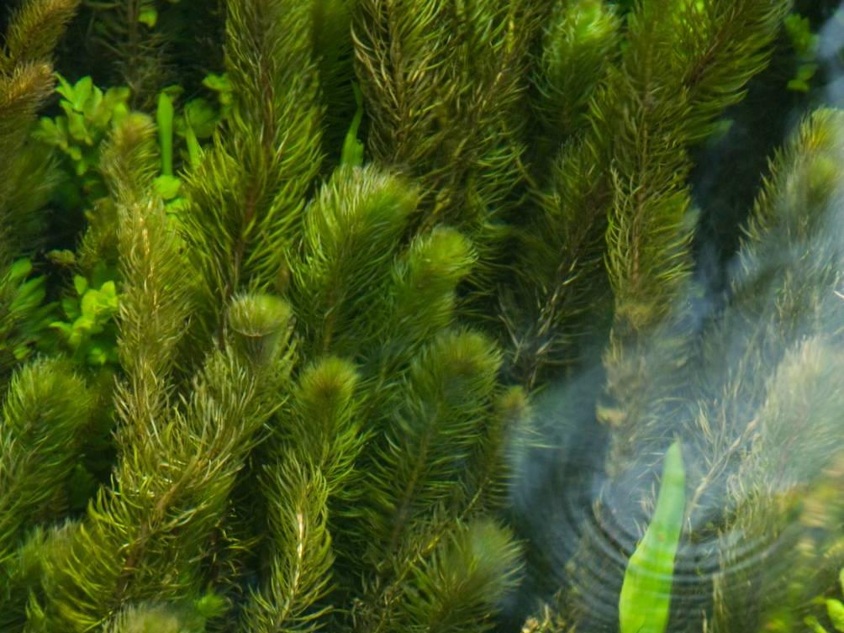







Aquatic Plant INNS: ID and Impacts
Name of presenter

Slide 2

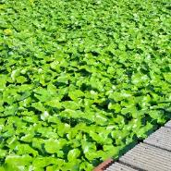

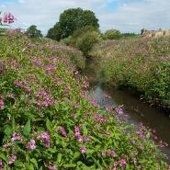
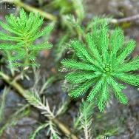
Invasive Non-Native Species (INNS)
This presentation will cover the following invasive non-native plant species:
Carolina Fanwort
Water Primrose
Two Leaf Water Milfoil
Parrot’s Feather

Slide 3
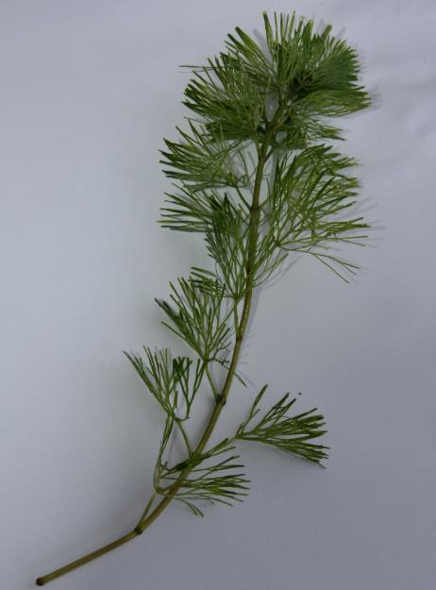
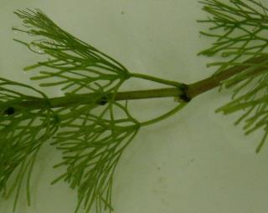

Carolina Fanwort (Water-shield)
Cabomba caroliniana
Fully submerged perennial plant – can grow up to 2 metres in length
Finely divided, fan-shaped leaves
Can appear tubular underwater
© GBNNSS
Leaves usually grow in opposite pairs, not in whorls
© GBNNSS
Notes:
First up, Carolina Fanwort.
Normally occurs as a fully submerged perennial aquatic plant that can grow to 2 metres long, rooting in the bed of the water body. It has finely divided fan-shaped dark green leaves attached to the stem in pairs. Can have a tubular appearance in water due to the way the leaves are arranged under the water. Occasionally it produces small, diamond-shaped, entire, floating leaves borne on the flowering stem. The solitary flowers (less than 2 cm across) range in colour from white to pale yellow occasionally with a pink or purplish tinge. The flowers emerge on stalks at the ends of the stems.
Dies back over winter but will still be present, so identification is possible all year round.

Slide 4
Carolina Fanwort (Water-shield)
Cabomba caroliniana
Water-milfoil species
Native and non-native
(Myriophyllum species)
Water Crow-foot species
Native
(Ranunculus species)
Leaves in whorls along stem
Leaves are herring-bone shaped
Finely divided, fan- shaped leaves
Leaves alternate along the stem
Water-shield species
Non-native
(Cabomba species)
Hornwort species
Native
(Ceratophyllum species)
Leaves in pairs along the stem
Finely divided, fan-shaped leaves
Leaves in whorls along stem
Leaves have ends like tuning forks
Notes:
There are a number of confusion species, but with careful examination can be identified.
Key feature for water-shield is leaves in pairs with finely divided fan shaped leaves.
Native and non-native water-milfoil species have herring-bone shaped leaves that grow in whorls. Non-native water milfoil will be covered later in the presentation.
Native water crow-foot has leaves that grow alternatively along the stem.
Native hornwort species has ‘tuning fork’ shaped leaves that also grow in whorls.

Slide 5
Carolina Fanwort (Water-shield)
Cabomba caroliniana
First recorded in 1969 in the Forth and Clyde canal, and then in 1990 in the Basingstoke canal where it is still present.
Popular aquarium plant, so introductions likely to come from intentional release.
Can be found in ponds, canals, lakes and slow-moving rivers, growing down to 3m.
Notes:
Native in eastern north and south America.
It was first recorded in the Forth and Clyde Canal in 1969 and the Basingstoke Canal in 1990. It is a popular aquarium plant and plants in the wild are probably due to
intentional introductions from aquaria. Although it is not widespread in the UK, it has become an invasive weed in many other countries and has become naturalized in North America, India, Japan and Australasia. It could potentially spread in the UK.
Carolina Fanwort is listed under Schedule 9 to the Wildlife and Countryside Act 1981 with respect to England, Wales and Scotland. As such it is an offence to plant or otherwise cause this species to grow in the wild.

Slide 6
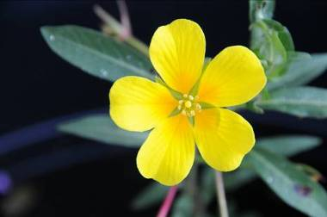
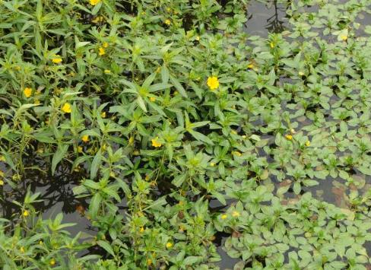
Water Primrose
Ludwigia grandiflora hexapetala
Bright yellow flowers with five petals grow on erect stalks 1.5-2.5cm long.
Stems 20-80cm long
Anthers 2.5-3.5mm
© GBNNSS
© GBNNSS
Notes:
Water Primrose is a stoloniferous (which means it lays down runners) perennial aquatic herb which often forms large floating mats.
Flowers are bright yellow with five petals. Present in July and August and best chance of finding and identifying this species.
Grow on erect stalks usually 1.5-2.5cm long
Flowers have anthers 2.5-3.5mm.

Slide 7
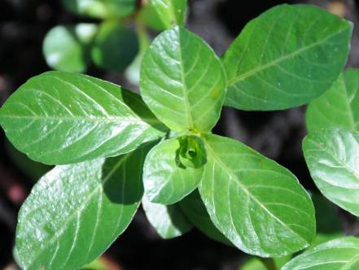
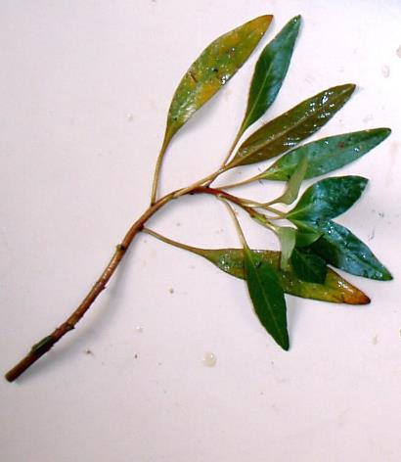
Water Primrose
Ludwigia grandiflora hexapetala
Leaves are 4-8cm, dark green with lighter central vein
Grow alternatively along stem
Floating © GBNNSS
Highly variable between floating and emergent forms.
Emergent. © GBNNSS
Notes:
Leaves are 4-8cm long, dark green in colour with lighter central vein.
Grow alternatively along stem.
Shape varies considerably between emergent and floating forms, from short and round (left picture) to long and thin (right picture).
Floating leaves are round or egg shaped, emergent are long and slender.

Slide 8
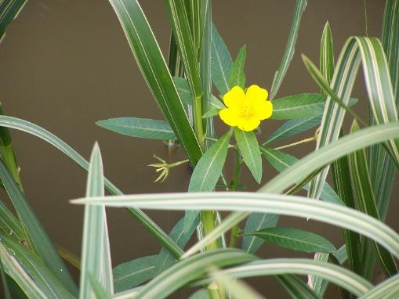
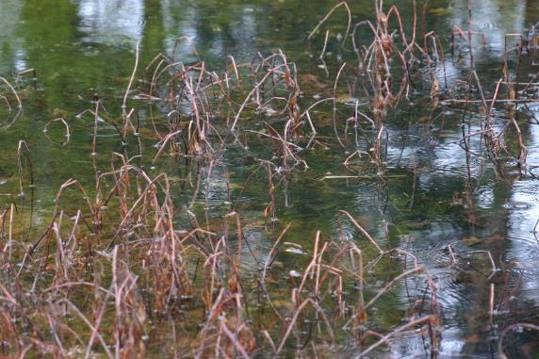
Water Primrose
Ludwigia grandiflora hexapetala
Dies off in winter to leave distinct red-brown stems
© GBNNSS
Emergent form, showing long, slender leaves and single yellow flower at end of stem
© GBNNSS
Notes:
Identifiable all year round. As it dies off over winter, leaves distinct red-brown standing stems behind.
It is incredibly similar to another species, Floating Water Primrose Ludwigia peploides, which is an invasive species in France but is not believed to have reached the UK yet.

Slide 9
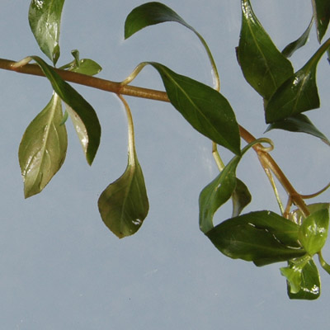
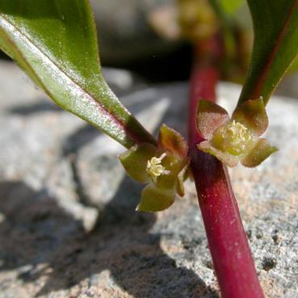
Water Primrose
Ludwigia grandiflora hexapetala
Confusion species: Hampshire Purslane Ludwigia palustris
Leaves grow in opposite pairs on stem
Flowers completely different – greenish and very small
© Keir Morse
Hampshire Purslane © GBNNSS
Hampshire Purslane © GBNNSS
Notes:
Hampshire purslane is a rare plant, restricted to Hampshire (New Forest) and Dorset.
Leaves grow in opposite pairs (rather than alternatively in water primrose).
Flowers completely different, small and green.
Also significantly shorter than water primrose, 20-60cm.

Slide 10
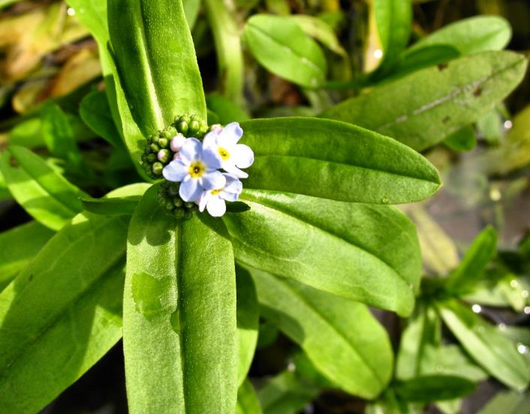
Water Primrose
Ludwigia grandiflora hexapetala
Confusion species: Water forget-me-not Myosotis scorpioides
Leaves have distinct ribbed central vein and flowers are small and sky-blue to pink
Water forget-me-not © GBNNSS
Notes:
Water forget-me-not is common on margins of aquatic habitats.
It has no floating leaves, always emergent, with distinct ribbed central vein.
Flowers are usually sky-blue, sometimes pink.

Slide 11
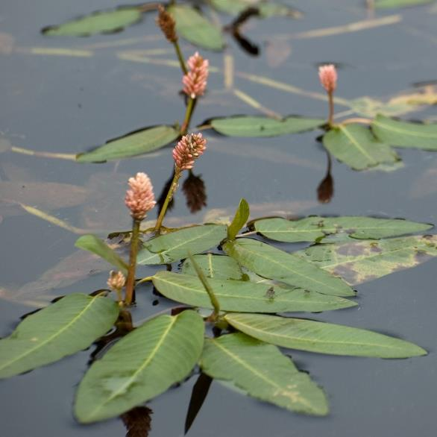
Water Primrose
Ludwigia grandiflora hexapetala
Confusion species: Amphibious bistort Persicaria amphibia
Floating leaves can be similar to the emergent leaves of of Water Primrose
Flowers very distinct – pink, small and clustered
Amphibious bistort © GBNNSS
Notes:
Amphibious bistort is fairly common throughout UK.
Floating leaves can be similar to emergent leaves of water primrose, and can also have terrestrial form!
Best separated by distinct pink flowers.

Slide 12
Water Primrose
Ludwigia grandiflora hexapetala
Established and spreading rapidly in mainland Europe.
Known from limited sites in England and Wales, partly down to efforts to eradicate when found.
Present in garden ponds where it is likely fragments of stems are translocated by wildlife.
Grows in ponds and slow-moving rivers.
Notes:
Native to South America. It is already established in a number of countries in mainland Europe and is spreading rapidly.
It has been found in a few sites in central and southern England, and one in Lancashire, but has the potential to turn up anywhere.
Used as an ornamental plant in ponds, where it can be picked up by wildlife e.g. birds and spread to other water bodies. It easily grows from stem fragments.

Slide 13
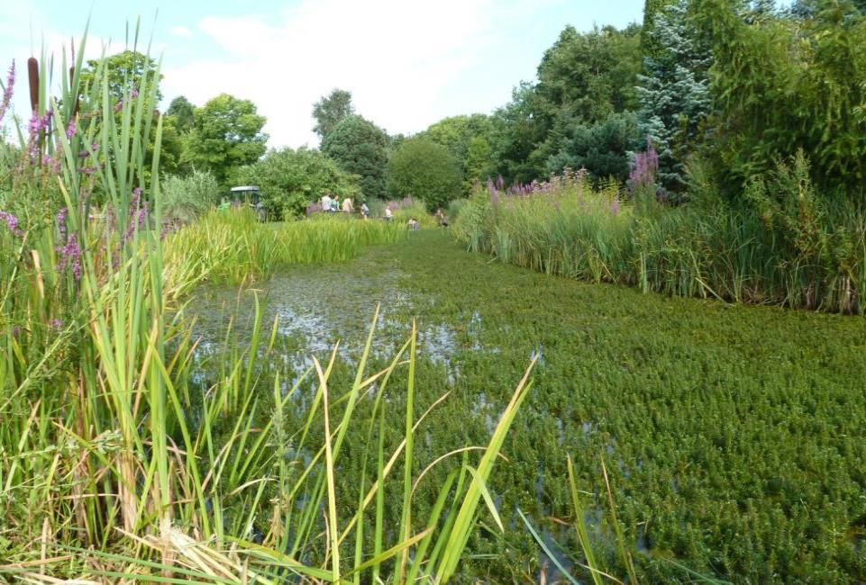
Two Leaf (Variable) Watermilfoil
Myriophyllum heterophyllum
Photographer Andreas Hussner
Notes:
Perennial evergreen submerged aquatic plant, mainly submerged but with emergent leaf spikes that very rarely contain flowers.
This is an example from Europe where the entire water body has been clogged by this species.

Slide 14
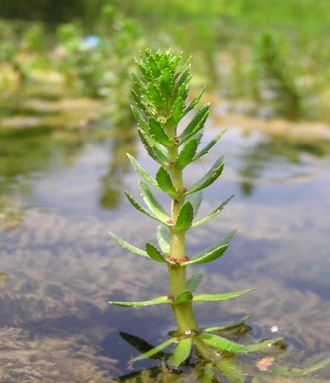
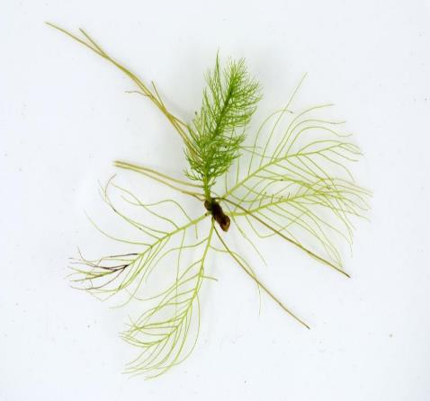
Two Leaf (Variable) Watermilfoil
Myriophyllum heterophyllum
Emergent spike with toothed leaves
Submerged leaves are feather-like and pinnate, with 4-10 pinnae
Photographer Andreas Hussner
Photographer Andreas Hussner
Notes:
Submerged leaves are feather-like and pinnate (2-5 cm long and 2-4 cm wide). Each leaf has 4-10 pinnae.
Emergent leaves are narrowly oval, pointed and sometimes edges may be toothed.
Flowering is very rare in non-native range and therefore not useful for ID.
It is incredibly similar to a number of other Myriophyllum species. A key difference is that none of the native Myriophyllum species have emergent leaf spikes. The only emergent parts of any of these species are the flowers.
Non-native Parrot’s-feather Myriophyllum aquaticum also has emergent leaf spikes and similar leaves, and is also much more common than Variable Watermilfoil in southern England. We'll discuss the ID of that species in a minute.

Slide 15
Two Leaf (Variable) Watermilfoil
Myriophyllum heterophyllum
Native to eastern USA.
Established in one site in the UK, present in a number of European countries.
Present in garden ponds as an ornamental plant, but is also often misidentified and sold under other names.
Capable of growing in a variety of conditions.
Notes:
This species is native to the eastern USA, although the exact boundaries of its native range are disputed, and in New Hampshire and Maine it is regarded as an invasive species.
It is established only in one site in the UK, and it has already established in a number of countries in Europe, including France and the Netherlands.
It is used as an ornamental plant, but its sale is banned in some countries, and it is frequently mislabelled and sold under other names, usually M. scabratum, M. propinquum and M. hippuroides.
It is capable of growing in a variety of conditions, including slow moving rivers, irrigation channels, ponds, lakes, canals and damp ditches. It also has a semi-terrestrial form, but this is not sustainable and is only used as a survival strategy.

Slide 16
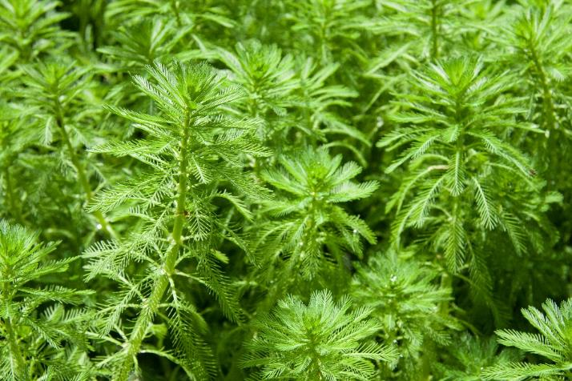

Parrot’s-feather
Myriophyllum aquaticum
Parrot’s-feather
Two-leaf Watermilfoil
© GBNNSS
Photographer Andreas Hussner
Notes:
Parrot’s-feather is another invasive non-native Myriophyllum species. It is worth keeping an eye out for and reporting it too.
It is similar to Watermilfoil, but the leaves of emergent spikes are pinnate (feathery), rather than toothed as in Watermilfoil. Submerged leaves are rare, only present in fast flowing water, and are limp and brownish. Emergent spikes are anything up to 30cm long, with the trailing stems reaching anything up to 2 metres. Flowers are inconspicuous, 2mm in diameter and white, emerging in July and August.

Slide 17
Parrot’s-feather
Myriophyllum aquaticum
Native to south America.
Established and spreading rapidly in southern England. Has been growing in the wild since 1960.
Present in garden ponds where it is likely fragments of stems are translocated, either by wildlife or from garden throw-outs.
Prefers sheltered and nutrient-rich water bodies e.g. ponds and ditches but also reservoirs, canals and other water bodies.
Notes:
Parrot’s-feather is native to south America. It first reached the UK in the late 19th century, but didn’t establish in the wild until 1960. Since then it has spread rapidly across southern England and is now fairly common as far north as York. It is used as an ornamental plant in ponds, where fragments are picked up and spread to the wild. Spread is only from vegetative reproduction.
It prefers to grow in sheltered, nutrient-rich water bodies like ponds and ditches, but is adaptable and can be found growing in reservoirs, canals and other water bodies. It is frost-tolerant so can be found throughout the year.

Slide 18
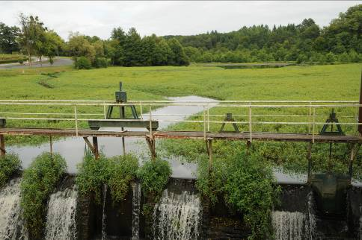
Invasive Non-Native Aquatic Plants
Impacts:
Out-compete native vegetation and clogs up waterways.
Reduce light and oxygen in the aquatic environment
© GBNNSS
Notes:
The main threat from all four of the species of aquatic plant mentioned is that they out-compete native vegetation and can completely clog waterways, as can be seen in the picture of water primrose.
Dense mats can be formed, eventually providing suitable habitat for successional species such as grasses and sedges, which causes the areas to dry out and for floating islands to be formed. This then has the potential to cause loss of water from irrigation channels, serious flood issues and block waterways for recreational users

Slide 19


Reporting
Any sightings of Carolina Fanwort, Water Primrose, Two-leaf Variable Watermilfoil or Parrot’s Feather in the UK should be reported – with a photograph and accurate location if possible.
Report sightings by using iRecord (https://www.brc.ac.uk/irecord/ or the iRecord app) or by emailing alertnonnative@ceh.ac.uk

