Slide 1
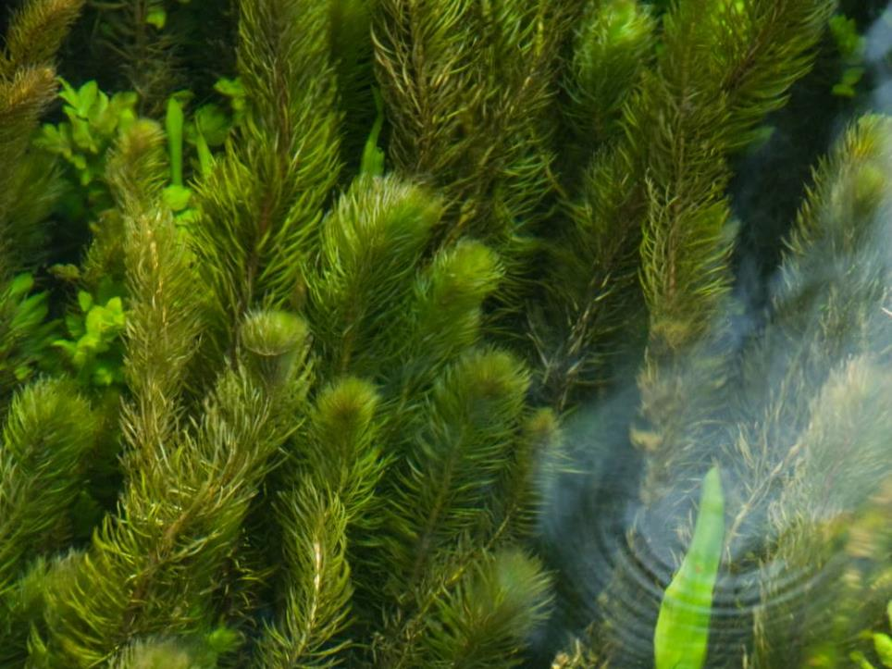
MARINE INVASIVE NON-NATIVE SPECIES
Name of presenter
Notes:
NB THIS PRESENTATION SHOULD BE TAILORED TO YOUR AUDIENCE. DELETE OR ADD SLIDES AS REQUIRED.

Slide 2
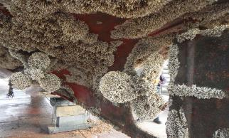
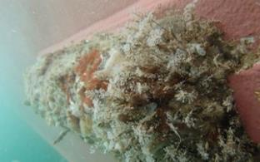
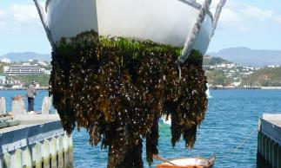
Marine Invasive Non-Native Species
Impacts on Marina and Large Yacht Club Managers and Practical Biosecurity Steps
Hull fouling banner Images Ficopomatus enigmaticus, © R Holland; Hull fouling, © Copyright 2018 International Maritime Organization (IMO); Undaria pinnatifida on a boat hull, © Lesley Patston, MPI
Notes:
BE AWARE OF YOUR AUDIENCE: THIS PRESENTATION IS TARGETED AT MARINA MANAGERS. A MORE VARIED GROUP WILL REQUIRED AN ADAPATED PRESENTATION.

Slide 3
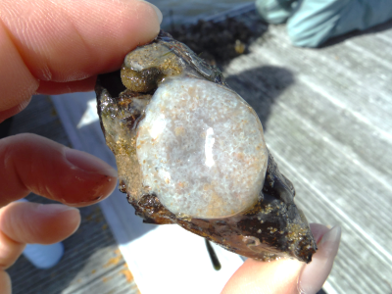
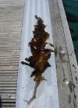
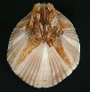
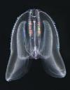
What are Non-Native Species?
Non-Native Species (NNS) are outside their normal / native range because of people.
Non-native Species becoming a problem are called ‘invasive’ (INNS).
NNS can also be called ‘non-indigenous’ or ‘alien’ species (IAS: Invasive Alien Species)
Images Top Row: Acartia tonsa, Moira Galbraith (CC) BY-NC-SA 4.0; Asterocarpa humilis, © J Bishop, MBA; Aplidium cf. glabrum, © B Lynam; Ammothea hilgendorfi, © J Bishop, MBA; Botrylloides diegensis, © J Bishop, MBA; Bugula neritina, © J Bishop, MBA. Left Hand Side: Caulacanthus okamurae, © Matt Slater, CWT; Ciona robusta, © J Bishop, MBA; Amphibalanus amphitrite, © J Bishop, MBA. Bottom Row: Codium fragile fragile, © www.aphotomarine.com; Corella eumyota, © J Bishop, MBA; Dyspanopeus sayi, © Museo di Storia Naturale di Venezia; Didemnum vexillum, © S Brown, C2W; Diadumene lineata, © J Bishop, MBA; Eriocheir sinensis, © Phil Crabb, NHM. Right Hand Side: Ficopomatus enigmaticus, © J Bishop, MBA; Undaria pinnatifida, © Crown copyright 2009, Kathryn Birch, CCW; Mnemiopsis leidyi © LJ Hansson.
Notes:
I’m going to talk to you today/tonight about the threat from invasive species in the marine environment and what we can do about it. I have a presentation which will take about half an hour which I hope will give you a useful insight into the world of invasive non-native species. I am happy to take questions at the end.
By the end of this short presentation I hope I will have given you not only a useful insight into the world of invasive species but also shown you that there are many actions we can all take to reduce the risk of their spread and reduce the impact of their growth.
But first… a short animation (6 minutes) which will give you insight into invasive non-native species, how they get here and what their impacts are when they become invasive.

Slide 4
Notes:
Link to YouTube video. Requires web access and can take a minute to load and play.
Here is the link in case the one within the Powerpoint doesn’t work: https://www.youtube.com/watch?v=EoggtzYr4Qk

Slide 5
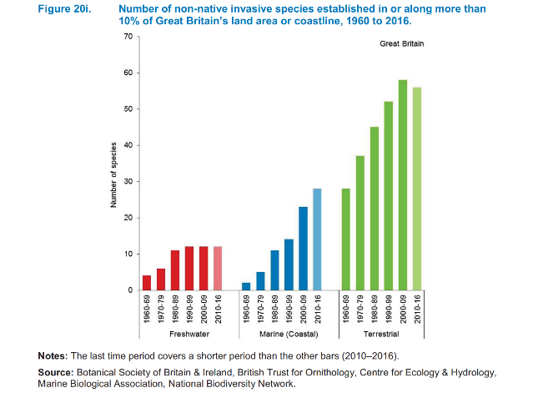
Ever Increasing Invasives
Notes:
Invasive non-native species are becoming more prevalent, becoming established in or along more than 10 per cent of Great Britain’s land area or coastline, increasing the pressure on native biodiversity.

Slide 6
Economic Impact
£1.7bn overall
£100m in marine environment.
Likely to be a large under estimate.
Demonstrates the most impacted sectors.
‘Figures based on The Economic Cost of Invasive Non-Native Species on Great Britain, F. Williams, R. Eschen, A. Harris, D. Djeddour, C. Pratt, R.S. Shaw, S. Varia, J. Lamontagne-Godwin, S.E. Thomas, S.T. Murphy, CAB/001/09 November 2010’
Notes:
The cost of this is significant – estimates say that all INNS, on land and in the sea, cost the UK around £1.7bn with almost £100 million being attributed to their management in the marine environment, more than £30 million of this attributable to marine recreation alone.
This is likely to be a significant underestimate as it is difficult to measure things such as the increased time it takes to clean marina infrastructure and boats, the potential for lost business and administrative costs associated with licences etc. It also is likely to under estimate the costs associated with drag due to hull fouling.
But SO WHAT?!
Invasive non-native species can impact on the ability of your marina to function efficiently and your facilities, as the cornerstone of the UK marine recreation sector, represent some of the higher risk sites for marine invasive non-native species to get settled before spreading around the UK.

Slide 7
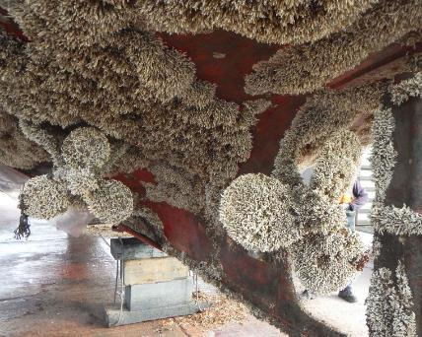
Trumpet Tube Worm on marina infrastructure and boat hull, South Coast of England. Images :Ficopomatus enigmaticus L-R © R Holland; © C Wood, MBA
Notes:
For example, the Trumpet Tube Worm (Ficopomatus enigmaticus) can grow at 2cm per month forming dense, heavy mats half a meter deep in less than a season, sinking infrastructure and damaging boats and staff with the sharp shells. While kelp species such as Wakame (Undaria pinnatifida) can grow to 3m in length and in one season became the dominant fouling species in Plymouth marina.

Slide 8
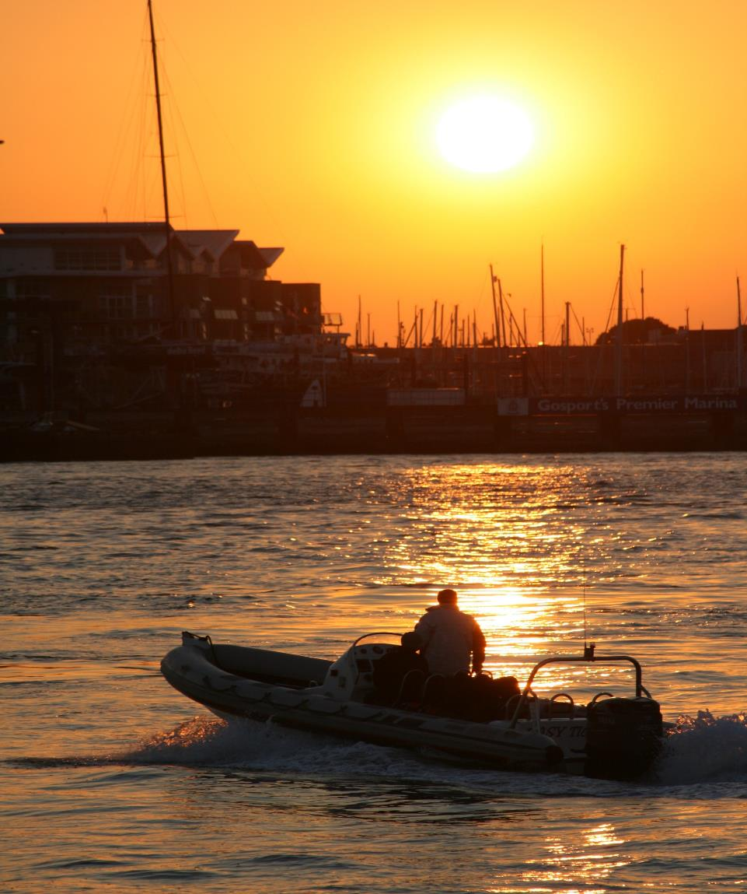
Complex Regulation
European Marine Strategy Framework Directive
International Convention for the Control and Management of Ships’ Ballast Water and Sediment
Invasive Alien Species regulation
pathways action plans
Legislation
European Water Framework Directive (WFD)
Listed species
European Strategy for Invasive Alien Species
EU Invasive Alien Species regulation
Schedule 9
Wildlife and Countryside Act 1981
Notes:
As a marina operator you will be starkly aware of the amount of regulation that surrounds your sector. From health and safety to border controls, marine licencing and planning, not to mention demands from customers.
Marina management depends on the many daily checks undertaken and records kept to ensure this multitude of regulations are adhered to.
However what may be new to you is that with new laws in place in many countries, you need to understand your responsibility to minimise the risk to your business from invasive non-native species.
The law in the UK varies across the different administrations. Generally more stringent and far reaching in Scotland, in England The Wildlife and Countryside Act 1981, and its various amendments, is the most important piece of legislation dealing with INNS.
You may also be aware of other pieces of legislation such as The European Strategy for Invasive Alien Species, the EU Invasive Alien Species regulation or the European Water Framework Directive. There is also the 2004 International Convention for the Control and Management of Ships’ Ballast Water and Sediment and other various legal regulations and standards.

Slide 9
Schedule 9
Chinese Mitten Crab Eriocheir sinensis
Slipper Limpet Crepidula fornicata
Giant Kelp Macrocystis angustifolia
Giant Kelp Macrocystis integrifolia
Giant Kelp Macrocystis laevis
Giant Kelp Macrocystis pyrifera
Japanese Kelp Laminaria japonica
Green Seafingers Codium fragile
Green Seafingers Codium fragile tomentosoides
Californian Red Seaweed Pikea californica
Hooked Asparagus Seaweed Asparagopsis armata
Japanese Seaweed Sargassum muticum
Laver Seaweeds (except native Porphyra species P. amethystea, P. leucosticte , P. linearis , P. miniata , P. purpurea & P. umbilicalis)
Wakame Undaria pinnatifida
BIOSECURITY PLAN
----------------------------------------------------------------------------------------------------------------------------------------------------------------------------------------
-----------------------
-----------------------
-----------------------
------------------------------------------------------------------------------------------------------------------------------------------
----------------------------------------------
Notes:
In this talk I will focus on the Wildlife and Countryside Act. The Act makes it illegal to release, plant or allow to escape into the wild any animal or plant which is not ordinarily resident, or a regular visitor to Great Britain, or is listed in Schedule 9 of the Act.
Don’t worry too much about lists such as Schedule 9 however – getting caught up in identifying every species can be a fascinating, but
lengthy, distraction, potentially best left to expert taxonomists!
Although you don’t need a marine biology degree – identification of the species listed under Schedule 9 is useful and appointing a biosecurity manager for your site will be helpful so that they can spend some time becoming familiar with problem species.
Setting aside the pacific oyster for now, the essence is that the principle of ‘polluter pays’ remains in force throughout the UK, you would be well advised to do what you can to protect yourself and your business.
You may also be aware of other pieces of legislation such as The Marine Strategy Framework Directive, the European Strategy for Invasive Alien Species, the EU Invasive Alien Species regulation or the European Water Framework Directive. There is also the 2004 International Convention for the Control and Management of Ships’ Ballast Water and Sediment and other various legal regulations and standards.

Slide 10
Drivers for Change
Notes:
Other drivers for change include your customers and business partners who wish to see risks managed. The reputational gains from being a sustainable, INNS free, organisation are significant and most investors will expect to see you taking steps to reduce your risk.
This all may seem complex and perhaps you feel that you are already compliant with a host of regulations, however it is worthwhile investigating your existing systems to ensure that you are doing all that is practical to reduce your risk from INNS.

Slide 11
Notes:
Talk about the Check, Clean, Dry campaign and point them in the direction of more guidance on the GB NNSS website

Slide 12
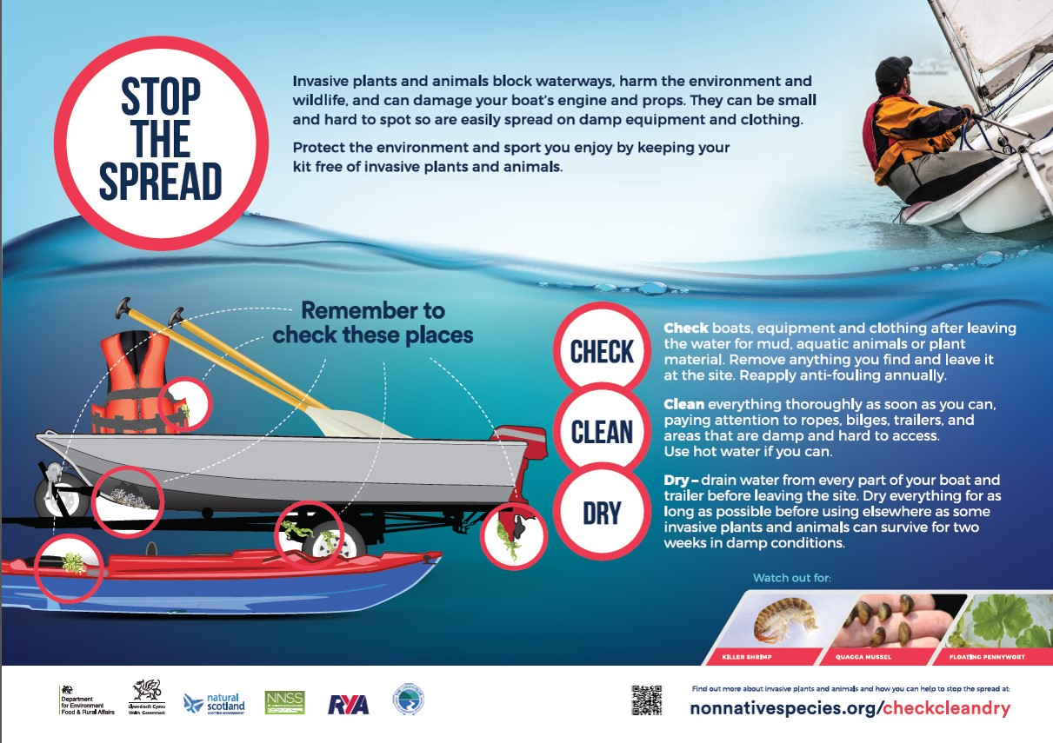
Check, Clean, Dry
Notes:
For participants the key is to give them enough warning to ensure they have time to clean their boats and kit effectively.
Ask all participants to ‘Check Clean Dry’ before they leave home (making sure all washdown and scraping material is disposed of appropriately). You could raise the issues through the relevant class association and you can also include guidance in the event paperwork – from when they register to inclusion in the rules of the day.

Slide 13
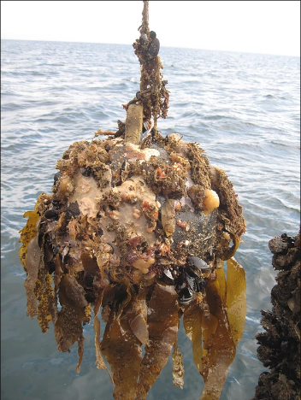
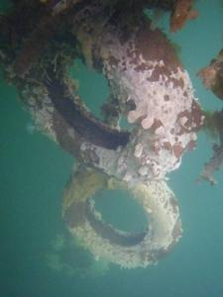
Remove unused items
INNS Carpet Sea-squirt Didemnum vexillum on unused tyre fenders. © Fiona Manson, SNH
A range of fouling including suspected INNS on unused mooring buoy.
Image courtesy of http://www.biofoulingsolutions.com.au/about2-c1eea?lightbox=c1980
Notes:
Avoiding the spread of INNS, and therefore prosecution, is not as difficult as you may at first suspect. Control of INNS is very difficult, particularly in the marine environment, and so legislators have avoided being too prescriptive about how to do it. Instead they request people ‘follow best practice’, mostly allowing users to define what is most appropriate for them.
The essence of good biosecurity is to identify the high-risk activities and then ensure that everyone plays their part in reducing the risk.
The low hanging fruit for marina managers includes:
Where practical, remove man-made structures from the water when they are not in use. In general INNS prefer artificial structures and removing what you can is an easy to do basic biosecurity measure. This could include temporary removal of items out of the preferred growth zone for example, if you have a muddy seabed, removal of mooring buoys in winter to a yard on land, and dropping the mooring chain to the seabed will smother fouling (attaching a riser to allow retrieval, of course!). It also means running a tidy site and not allowing old fenders, warps and so on to stay in the water.

Slide 14
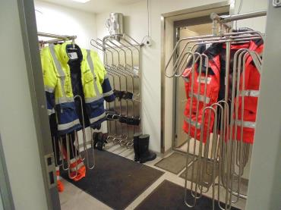
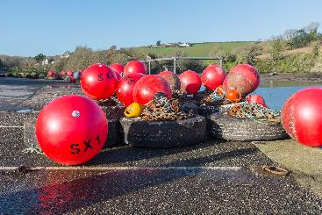
Dry what you can, when you can
Image courtesy of https://businessguide.offshoreenergytoday.com/profiles/view/pronomar_b_v
Nick Maslen / Alamy Stock Photo
Notes:
Air dry what you can, when you can. Most, if not all, marine and aquatic INNS are killed by dehydration. Identify opportunities to dry out equipment or infrastructure as often as possible. This could mean a drying room/area for dive kit, PPE etc. It can also mean identifying when vessels which are used less frequently, such as barges or dredgers, can be hauled out and dry stored.

Slide 15
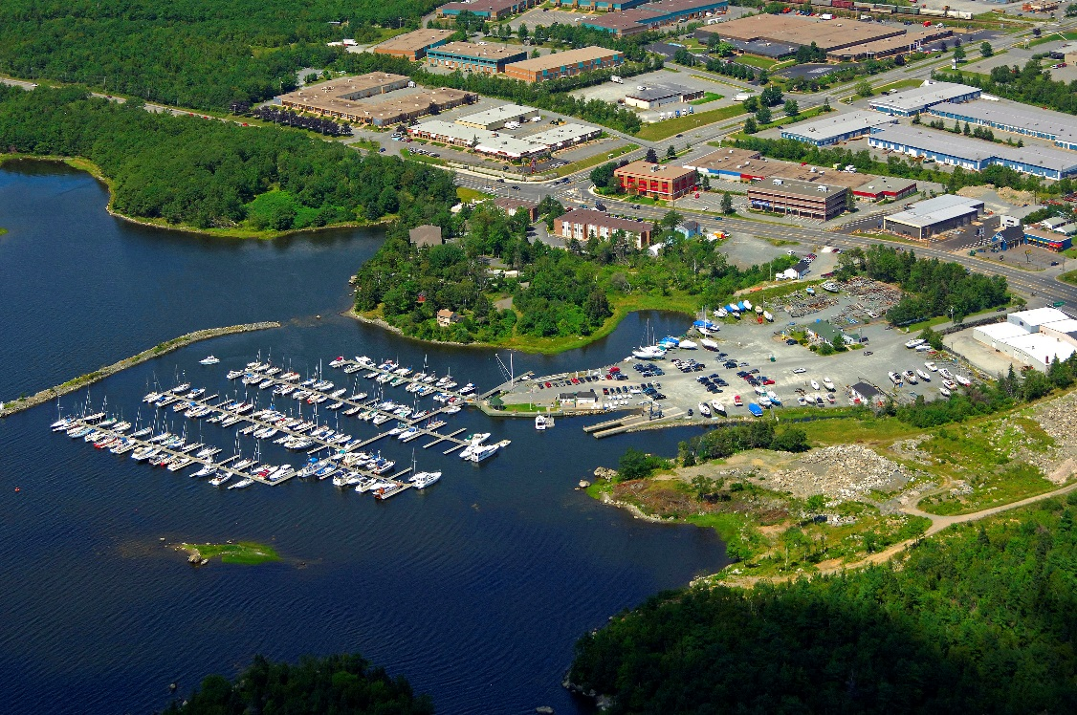
Make the best use of freshwater coming onto the site
Notes:
Expose to fresh water. Make the most of any natural flows of freshwater into your site. Marine INNS need some degree of salinity to sustain their life cycle – if you can expose them to fresh water through immersion or wash down you will reduce the risk posed by INNS. Likewise species adapted to survive in brackish water can be killed off by exposure to full salinity.
Image credit: https://marinas.com/view/marina/ywcdry_Dartmouth_Yacht_Club_Marina_Dartmouth_NS_Canada

Slide 16
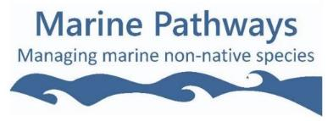
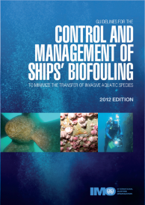
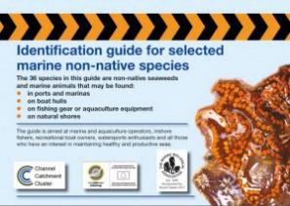
Raise Awareness
Notes:
Raise awareness. Many people, including many of your staff, are mostly unaware of marine INNS and the threats associated with them and raising awareness often empowers people to take action. Whilst it is not necessary to become a marine biologist, some idea of what to look out for gets people interested and increases effective reporting. There are plenty of free or low cost ID guides available on the web, and some good resources on the Marine Pathway website, or you could do your own, site specific guide. Train your staff to be alert to unusual growth in the marine environment and get them to look out for it when undertaking routine visual inspections of infrastructure and vessels. Place visual aids in mess rooms and offices to aid familiarity.
So how does all this relate to the legislation we discussed earlier?
In essence, by undertaking these actions you are demonstrating ‘best practice’. By recording it all in one document – your biosecurity plan – you can show anyone who may have concerns about your activities that you are taking all reasonable steps to lower the risk of introducing or spreading invasive non-native species.

Slide 17
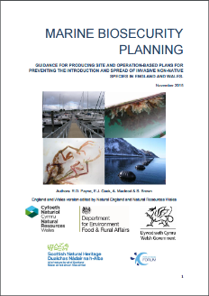
Biosecurity Planning – the next logical step
Understand your site
Understand how INNS are introduced to your site
List site activities
List biosecurity measure
Contingency, monitoring and surveillance
Notes:
You can take these actions to their logical conclusion and do a full biosecurity plan for your site. This involves a five step process.

Slide 18
Section 1 - Introduction
BIOSECURITY PLAN
----------------------------------------------------------------------------------------------------------------------------------------------------------------------------------------
-----------------------
-----------------------
-----------------------
------------------------------------------------------------------------------------------------------------------------------------------
----------------------------------------------
Why are you writing a biosecurity plan?
What are the major concerns for our business?
Notes:
Your opening section sets the scene for why you are doing a biosecurity plan and what the major concerns are for your business. For example, you may be concerned about effects on the environment and legal or reputational impacts.

Slide 19
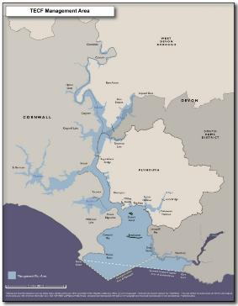
Section 2 – Scene Setting
Identify the area covered by the plan
Geographical scope
Time limits
Activities
Useful contacts
Local Natural England staff
Relevant experts, marine biologists, biosecurity experts, university contacts etc.
Fig 1: TECF Management Area
CHOOSE AN IMAGE RELEVANT TO YOUR AUDIENCE
Notes:
Here you identify what geographical area or activity is to be covered by the plan. This section should also outline support from senior management and identify a member of staff who is responsible for enacting and updating the Plan.
(examples from the Tamar Estuary Biosecurity Plan) Map source: http://web.plymouth.gov.uk/tecf

Slide 20
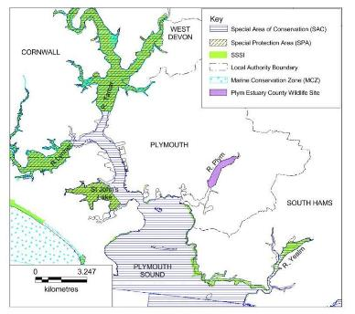
Section 3 – Environmental Information
Physical structure and layout of the site
Water chemistry, temperature and other relevant data
Lists of INNS known to be present or on the horizon
Existing designations e.g. SSSI or MCZ etc.
CHOOSE AN IMAGE RELEVANT TO YOUR AUDIENCE
Notes:
In this section you should delve into more detail about the physical characteristics of the area covered by the Plan. Gather as much information as you can about the chemistry of the waters local to your business. Salinity and temperature information can often be found online, or your company may already record it as part of their normal business. Try comparing this data to the known preferences of some of the INNS found on the GB non-native species secretariat website to narrow down your list of concerns.
Also find out about any existing designations for example, is the area a SSSI (Site of Special Scientific Interest) or have other protected status such as an MCZ (Marine Conservation Zone)? If so contact Natural England to find out more about INNS and current management of marine protected areas locally.
Map source: http://web.plymouth.gov.uk/tecf

Slide 21
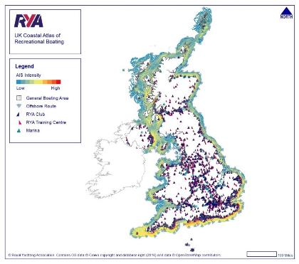
Section 4 – Use of the Area
Major types of activity
How many boats?
What type? Ballast water used?
Where are they coming from?
What stock or product movements are there?
Notes:
Here you will list the major types of activity you expect in the area. How many boats, where are they coming from, what type of boats are they, do they contain ballast water? What sort of stock movements are common and what INNS could move with them? Again more information is available on the GB Secretariat website, links at the end. This section can be used to develop a risk assessment of types of activity and their potential to import or spread INNS.

Slide 22
Section 5 – Biosecurity Actions
DELETE TEXT IN RED BEFORE USE. EDIT ACTIONS TO PROVIDE A LIST RELEVANT TO YOUR AUDIENCE
Shore Side
Encourage an open culture of reporting unusual sightings.
Establish a point of contact for INNS with local Natural England staff.
Always wash down equipment well away from the water’s edge to ensure that no residues can return to the sea.
Invest in a boat wash down facility which captures the run off and doesn’t allow untreated water to return to the sea.
Encourage ‘open access’ recording of INNS by researchers, students, volunteers and amateur taxonomists.
Notes:
Perhaps the most important section. Here you outline the actions you plan to take to improve your biosecurity. These should be based on what we discussed earlier, but the final list will vary depending upon the activities and partners involved. Aim to stay practical – you can always include a ‘wish list’ of other actions should time and budget allow. Some examples of these are:
(NB this is a simplified list – more actions available on the website)
(Good to emphasise = residues from wash down may include live material along with antifouling paint flakes and solutions. )
(READ ACTIONS FROM SLIDES AS TIME ALLOWS)
(EDIT SLIDES TO AUDIENCE AND TIME)

Slide 23
Section 5 – Biosecurity Actions
DELETE TEXT IN RED BEFORE USE. EDIT ACTIONS TO PROVIDE A LIST RELEVANT TO YOUR AUDIENCE
Vessels – work boats or customers and members boats
Ensure all boats are effectively and appropriately treated with antifouling coatings.
Ensure that visiting boats arrive clean by stating it clearly in your guide for visitors.
Annual haul out and cleaning of all customers boat hulls should be encouraged and should be done as a minimum for work boats.
Make vessel haul-out facilities, with wash-down capture, and dry stack options available to customers.
Make The Green Blue advice available to customers.
Include biosecurity information in communications with berth holders e.g. in the annual handbook.
Raise awareness of key INNS and encourage reporting particularly by wash down staff.
BIOSECURITY PLAN
----------------------------------------------------------------------------------------------------------------------------------------------------------------------------------------
-----------------------
-----------------------
-----------------------
----------------------------------------------------------------------------------------------------------------------------------------------------------------------------------------------------------------------------------------------------------

Slide 24
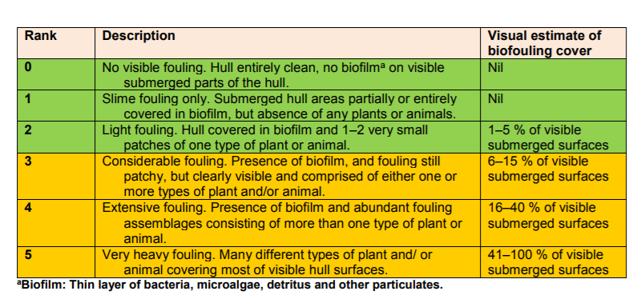
Hull Fouling Ranking Table
GUIDANCE FOR PRODUCING SITE AND OPERATION-BASED PLANS FOR PREVENTING THE INTRODUCTION AND SPREAD OF INVASIVE NON-NATIVE SPECIES IN ENGLAND AND WALES. November 2015, R.D. Payne, E.J. Cook, A. Macleod & S. Brown
Notes:
You can check the level of hull fouling against the table. A quick look is enough to gauge the cleanliness of a boat from the surface but niche areas, for example around water intakes, or high wear areas, for example around the propeller, can harbour INNS – investing in a low cost waterproof camera and an extension stick can let you see these hard to reach areas and give you a more robust idea of the level of hull fouling. If you are only looking from the surface then look to see if there is more than a low level of hull slime (2 or less in the table above) at the water line. If there is, it is time to clean.
Always reinforce the message that any concerns staff have can be escalated if necessary so that you can deal with them appropriately.

Slide 25
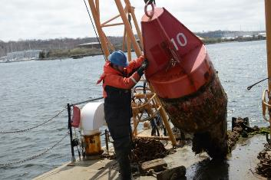
Section 5 – Biosecurity Actions
DELETE TEXT IN RED BEFORE USE. EDIT ACTIONS TO PROVIDE A LIST RELEVANT TO YOUR AUDIENCE
Monitoring
Identify submerged structures suitable for regular inspection. Photograph/video the areas and keep a record.
Consider using any regularly maintained infrastructure as early warning system e.g. navigation buoys/pontoons which are regularly removed from the water.
Aim to identify any areas of INNS and focus in on these as appropriate for monitoring.
© Candy Thomson/Baltimore Sun video

Slide 26
Section 5 – Biosecurity Actions
Tenants and Contractors
Check all relevant tenants are aware of the need for clean hulls on all vessels including work boats and those in the brokerage.
Ensure contractors are aware of your biosecurity requirements.
Encourage tenants to carryout hull/equipment cleaning and ensure no water goes back into marine environment.

Slide 27
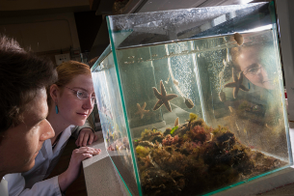
Section 5 – Biosecurity Actions
Research
Understand tidal currents and salinity in your area.
Understand the invasive species known to be in your area. Lists of both horizon scanning species and known invaders are on the website.
Work with researchers and coatings manufacturers to develop a network of settlement panels to test different coatings.
Image © University of Liverpool

Slide 28
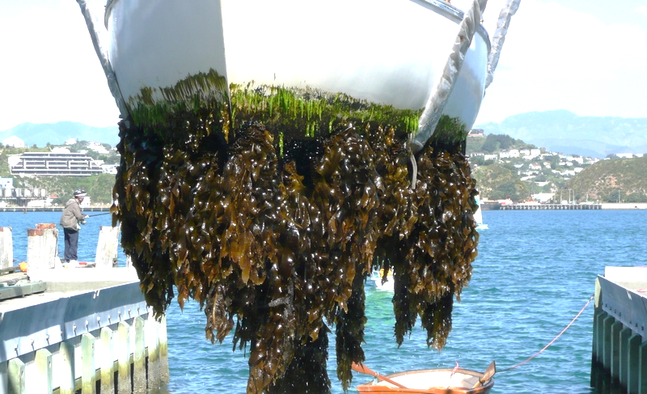
Washdown
Image © Lesley Patston, MPI
Notes:
Remember that it is just as important to prevent INNS arriving in the area as it is to stop INNS leaving the site. To slow or halt the arrival of alien species ensure that any suppliers take their share of the responsibilities. Write into your contract with them that you expect arriving materials to be INNS free and that all kit, infrastructure, staff etc., will arrive clean and INNS free too.
On the site it is important to have relevant cleaning facilitates set up – this will range from a simple fresh water wash down area, well away from the water’s edge, through to a full lift and scrub facility for larger vessels where the run off is collected and not allowed to return to the sea untreated.
When doing routine inspection of boats for any structural problems also inspect them for obvious fouling. A quick look is enough to gauge the cleanliness of a boat. Look to see if there is more than a low level of hull slime at the water line. If there is it is time to clean.
Always reinforce the message that any concerns staff have can be escalated if necessary so that you can deal with them appropriately.

Slide 29
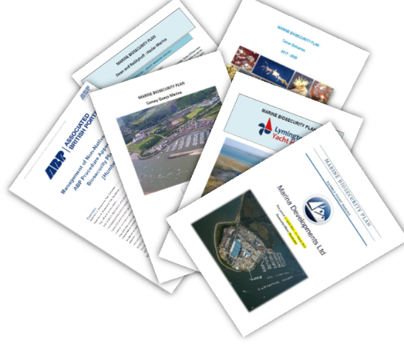
You are not alone!
Notes:
You may have been listening to all this and thinking ‘but does anyone really DO this?’. Let me give you a short case study before we have a chance for questions.
In 2016 contractors working for Natural England worked with Quay Marinas, MDL marina group, the Yacht Haven Group and Dean and Reddyhoff to help them work up biosecurity plans for their operations.
Each business working with the contractor to go through the five steps we just discussed and to agree practical biosecurity actions that could be used on their site. Each agreed that the process had been helpful and not as difficult as they had first suspected.
Practical actions included things like disseminating best practice to customers – this meant making The Green Blue materials available to people and promoting them. They also agreed to check their pontoons regularly, remove extra equipment from the water which didn’t need to be there and to train staff on identification and reporting.
Each group agreed to roll out what they had learnt with the single site example across their marina group and you can find examples of their biosecurity plans on the GB Secretariat site.
So, as you can see, biosecurity planning can be relatively easy to achieve and can protect you and your business from possible reputational and legal risks.

Slide 30
Contacts
Report INNS sightings by using iRecord (https://www.brc.ac.uk/irecord/ or the iRecord app) or by emailing alertnonnative@ceh.ac.uk
GB Non-Native Species Secretariat www.nonnativespecies.org
National Biodiversity Network – Distribution maps and information www.nbnatlas.org
RAPID LIFE: www.nonnativespecies.org/rapid
Notes:
I’d welcome any questions and if I can’t answer any of them I promise to make a note and get back to you with answers as soon as possible.

Slide 31
Thank you for listening Any questions?
Slides prepared by Sarah Brown, sarah@c2w.org.uk

