Slide 1
Contingency Response to Invasive Non-native Species
Name of presenter

Slide 2
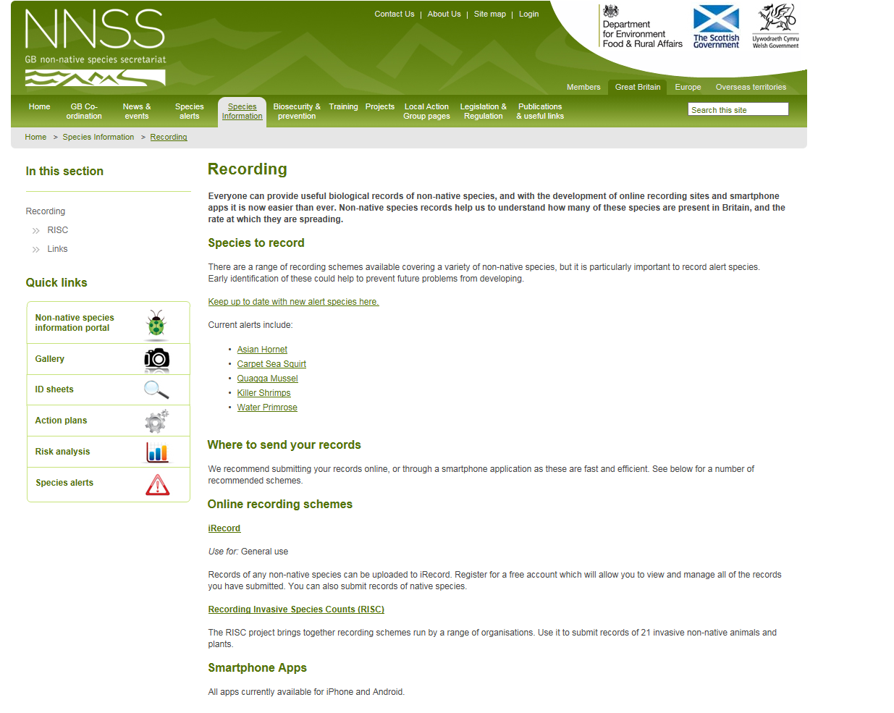
Reporting
Citizen science is essential for detecting and monitoring invasive non-native species
There are a number of different ways to record sightings.
iRecord is a great way to record sightings, either online (https://www.brc.ac.uk/irecord/) or by using the iRecord app on your phone.
All the methods of recording species can be found at www.nonnativespecies.org/recording
Notes:
Sightings from members of the public of non-native species are essential in the detection and containment of invasive non-native species. There is currently no dedicated INNS monitoring program. Although the Environment Agency and many NGOs carry out monitoring activity for other reasons e.g. water quality. Sightings from the public play an essential role in the detection of some species, hence why we’re all here today.
If you think you have found an INNS (Invasive non-native species) then it is important if you can to get photographs to help confirm identification. Sometimes specimens can be taken, for example of plants, but extreme caution needs to taken not to inadvertently spread it, as just a fragment of material can establish. It is also important to record exactly where you found the species, and the circumstances of the finding.
There are then a number of places to submit your sighting so that the relevant organisations are notified.
Submitting records via iRecord is the best option – these records go to all the relevant organisations, and it is easy to use. iRecord will ask for at a minimum the suspected species, the likelihood of correct identification, a grid reference and a date, but will also allow other details to be added, including photos and habitat type. You can use iRecord online (https://www.brc.ac.uk/irecord) or the iRecord app on your phone. There are also a number of other apps that can be downloaded onto smart phones, some of which are specific to certain species, which will allow you to upload your sightings directly through them.
There is also a dedicated email address to report sightings (alertnonnative@ceh.ac.uk). For more information on recording, visit www.nonnativespecies.org/recording

Slide 3
Priority species
Some invasive non-native species (INNS) are priority species for contingency response. This is usually because they are considered to be:
Highly likely to either become invasive in the UK or continue to spread rapidly if not controlled.
A serious threat to native species of flora and fauna.
A serious threat to economic interests e.g. aquaculture facilities.
Reports of these species will elicit a rapid response from the relevant authorities.
Notes:
Some INNS are priorities for contingency response. This is usually because they meet one or all of the following criteria:
They are highly like to become invasive in UK e.g. species that have spread rapidly and are thriving in Europe.
They pose a serious threat to native flora and fauna e.g. Signal Crayfish, which has already become well established and widespread and is causing serious declines in native crayfish species (more on that later).
They pose a serious threat to economic interests e.g. Carpet Sea-squirt which can overwhelm mussels and engulf underwater marine equipment (more on that later too).
It is especially important that sightings of these species are recorded. Submitting sightings to iRecord or via the email address alertnonnative@ceh.ac.uk will ensure that the relevant authorities are informed.
We can make informed predictions about the potential effects of invasive non-native species, but it is impossible to be certain what the effects will be (until it is too late). It is therefore important to deal with invasive non-natives as soon as possible, regardless of their perceived threat.
E.g. Asian Hornet. A nest was discovered near Wollacombe in Devon in September 2017; a team from the Animal and Plant Health Agency (APHA) was dispatched and the nest was treated and removed and surveillance zone set up around the outbreak within 3 weeks.

Slide 4
STAGE
RESPONSIBILITIES
Suspected sighting
Responsible authority investigate
Confirmed population
Responsible authority establish Response Group, who provide recommendations for action
Establish extent of population
Responsible authority establish Operational Group which implements immediate local biosecurity measures and site assessment with oversight of Response Group
Action to eradicate
Monitoring to confirm eradication
Response Group provides recommendation on whether to attempt eradication or move straight to containment / slowing the spread.
Eradication unsuccessful
Eradication successful
Response Group provides recommendation on whether to stand down, escalate eradication attempt or move to containment / slowing spread.
Stand down
Escalate
Return to pre-invasion footing
Contain or slow spread
Response Group provides recommendations for and national implementation of biosecurity measures, Operational Group implements local biosecurity
Notes:
This is a generic overview of how a response to an invasive non-native species (INNS) would be co-ordinated and managed.
Firstly, a report comes in of an invasive non-native species.
Once a sighting is confirmed, dependant on the species, a monitoring program would be set-up, to establish whether a population exists, and if so how big it is. Immediate biosecurity measures will also be implemented to prevent any potential spread of the INNS.
Once the population size has been established, there are two options. The first is to attempt an eradication. This will depend on the locations and the species. For example, eradicating a small population of Water Primrose would be feasible with an extended removal and treatment program. However, eradicating a population of Fathead Minnow that has colonised an entire river system could be difficult due to costs, time availability, source of contamination etc. This would be decided upon by a group of experts in the relevant fields.
If eradication is feasible, then the actions would be carried out and a monitoring program established, to determine whether the eradication had been successful and to monitor a potential re-invasion. If an eradication program proves successful, then there would be a return to pre-invasion footing. If it is not successful, then two options would be considered, either discontinue the eradication and move to containment, or escalate the eradication attempt if it is deemed that it would make a difference.
If eradication is not feasible, then a biosecurity programme would be implemented to prevent the species from spreading.

Slide 5
Receiving and confirming a sighting
Relevant authorities will determine if an incidental record requires a response.
Reports of priority species will be investigated, and a response initiated if a self-sustaining population is detected.
Identification issues will be resolved through consultations with experts and organisations as required.
Upon confirmation of a population of concern, a response group will be established.
Notes:
Incidental records of individual freshwater animals may not necessarily require a response. The relevant authority will determine when a record should be considered of concern, undertaking investigation as necessary and, where relevant, consulting other organisations e.g. the Environment Agency, the Department for Environment, Food, and Rural Affairs (Defra), the GB Non-native Species Secretariat (GB NNSS), the Animal and Plant Health Agency (APHA).
The relevant authority will determine whether a response is required, in consultation with other organisations.
Difficulties in resolving the identity of a specimen will be resolved with support of relevant organisations and experts as required.

Slide 6
Response on confirmation
A Response Group will be established, who will inform senior officials and ministers as necessary and establish the Operational Group.
The Operational Group will:
Asses the population
Initiate immediate biosecurity/containment measures
Undertake a biosecurity risk assessment
Provide advice on management
Undertake surveillance of other areas
Liaise with landowners and interested parties
Investigate outbreak source
There are a number of priorities on which recommendations would be based.
The Response Group then determines the course of action.
Notes:
A response group will be established, to act as advisors and relay information between the operational group (which they will set up) and senior officials and ministers as necessary.
The operational group will be responsible for a number of things:
Assess the affected area for the extent of the population of the INNS.
Initiate the immediate implementation of biosecurity measures, as advised by the response group.
Undertake a biosecurity risk assessment of pathways in and out of the affected area.
Informed by the surveys, provide advice on management (eradication or containment), which will include any site-specific issues.
Undertake surveillance of other water bodies that may be affected, dependant on risk analysis.
Liaise with land owners and interested parties, to secure access and gather site-specific information.
Identify and investigate outbreak source, to prevent further contamination, pursue appropriate legal action etc.
The response group will provide recommendations for actions, on advice from the operational group. There are a number of priorities that these recommendations will be based on:
The first priority is complete eradication.
The next priority is to contain the species. This will be informed by the biosecurity risk assessment undertaken by the operational group.
Where complete containment is unfeasible, measures should be implemented to slow the spread.
The Response Group will determine the appropriate course of action, in consultation with senior officials and Ministers as necessary, and communicate this decision back to the Operational Group. To help inform their decision the Response Group should undertake (or commission) a risk management appraisal, which would determine the feasibility of an eradication attempt. Ideally these will be in place prior to an invasion.

Slide 7
Rapid eradication
If a decision to eradicate is made, the following steps are taken by the each group.
Operational Group | Response Group
Produce an eradication strategy | Support the operational group
Liaise with landowners and interested parties as necessary | Liaise with national stakeholders
Implement the eradication strategy | Maintain an overview of the eradication strategy
Update the response group
Monitor the site post-eradication
Notes:
The operational group will do the following in the event of a decision to eradicate:
Produce an eradication strategy. The eradication strategy produced by the Operational Group will include any necessary biosecurity measures and identify any issues. This will be approved by the Response Group with senior officials if necessary.
Liaise with landowners and interested parties with the main aim of securing access.
Implement the eradication strategy once agreed upon.
Feed back regularly to the Response Group, including any required changes to the response plan, as well as reporting the need to escalate or stand down.
Monitor the site once the eradication is complete to ensure the INNS does not return.
The Response Group, during an eradication will:
Support the operational group by reviewing the eradication strategy and helping them to resolve issues.
Liaise with national stakeholders as necessary
Maintain an overview of the eradication strategy and make decisions on when to escalate or stand down.
The Response Group will also determine when the eradication phase can move to a monitoring phase and determine when monitoring can stop. It will advise senior officials/ministers if there is a need to escalate eradication efforts/stand down (based on info from the operational team) if, for example:
Eradication is unsuccessful or more difficult/expensive than initially thought.
New populations are discovered that cannot be eradicated.
If a decision is made to stand down, then the work will move to a containment/slowing the spread through enhanced biosecurity.

Slide 8
Containment or Slowing the Spread
Based on the biosecurity risk assessment and advice from the Operational Group, the Response Group will make recommendations for containment or slowing the advance of the INNS.
Operational Group | Response Group
Liaise with landowners/local stakeholders | Liaise with national stakeholders
Implement additional local biosecurity measures where appropriate | Develop and promote national biosecurity measures
Monitor the effectiveness of biosecurity | Consider or take forward regulatory or statutory measures
 | Monitor and review biosecurity measures
Notes:
Based on the biosecurity risk assessment and advice from the Operational Group, the Response Group will make recommendations for containment or slowing the advance of the INNS. This will be in consultation with senior officials/ministers where necessary, and then communicated back to the operational group.
The Operational Group will:
1. Liaise with local stakeholders and landowners to make them aware and seek support and or apply regulatory conditions with the goal of securing enhanced biosecurity.
2. Implement additional biosecurity measures where appropriate. This will include helping stakeholders/landowners to implement measures too, as there may be onus on them to do it.
3. Monitor the effectiveness of the biosecurity measures.
The response group will:
Liaise with national stakeholders to keep them aware of progress and to seek support and/or apply regulatory conditions.
Develop and promote national biosecurity measures as necessary.
Consider or take forward regulatory or statutory measures to improve biosecurity.
Monitor and review biosecurity as appropriate.
This is not an exhaustive list of the steps of a contingency response, and additional actions may be required as determined by the response group.

