Slide 1
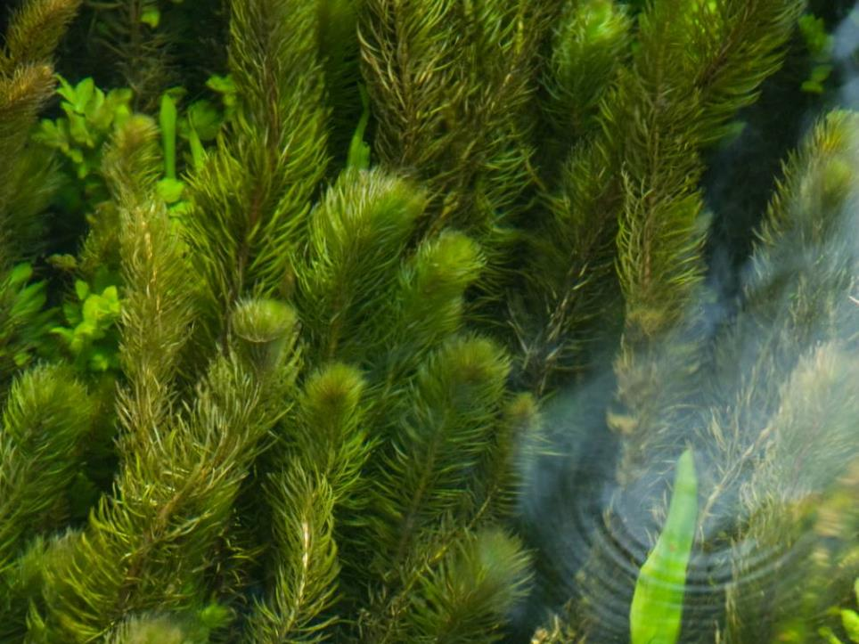
MARINE INVASIVE NON-NATIVE SPECIES
Name of presenter
Notes:
BE AWARE OF YOUR AUDIENCE: THIS PRESENTATION IS TARGETED AT COMMERCIAL FISHING. A MORE VARIED GROUP WILL REQUIRED AN ADAPTED PRESENTATION.

Slide 2
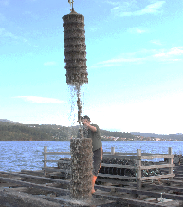
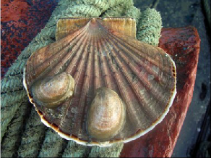
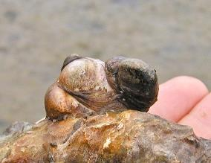
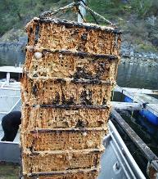
Marine Invasive Non-Native Species
Impacts on Mariculture and Practical Biosecurity Steps
Name of presenter
Impacts on aquaculture banner Images L-R Caprella mutica, © Grupo de Estudo do Medio Mariño (GEMM); Crepidula fornicata on scallop, © Rafael Bañón; Crepidula fornicata, © Puget Sound Sealife; Didemnum vexillum, © Gordon King
Notes:
THIS PRESENTATION SHOULD BE TAILORED TO YOUR AUDIENCE. DELETE OR ADD SLIDES AS REQUIRED.
Introduce yourself, your role and how you came to be working on invasive species. Give a brief, friendly and interesting overview.

Slide 3
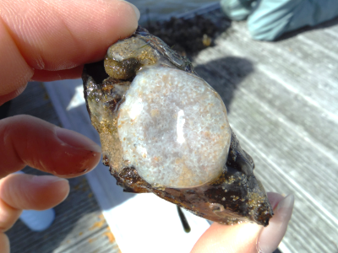
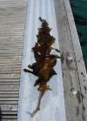
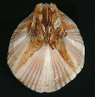
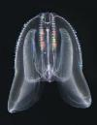
What are Non-Native Species?
Non-Native Species (NNS) are outside their normal / native range because of people.
Non-native Species becoming a problem are called ‘invasive’ (INNS).
NNS can also be called ‘non-indigenous’ or ‘alien’ species (IAS: Invasive Alien Species)
Images Top Row: Acartia tonsa, Moira Galbraith (CC) BY-NC-SA 4.0; Asterocarpa humilis, © J Bishop, MBA; Aplidium cf. glabrum, © B Lynam; Ammothea hilgendorfi, © J Bishop, MBA; Botrylloides diegensis, © J Bishop, MBA; Bugula neritina, © J Bishop, MBA. Left Hand Side: Caulacanthus okamurae, © Matt Slater, CWT; Ciona robusta, © J Bishop, MBA; Amphibalanus amphitrite, © J Bishop, MBA. Bottom Row: Codium fragile fragile, © www.aphotomarine.com; Corella eumyota, © J Bishop, MBA; Dyspanopeus sayi, © Museo di Storia Naturale di Venezia; Didemnum vexillum, © S Brown, C2W; Diadumene lineata, © J Bishop, MBA; Eriocheir sinensis, © Phil Crabb, NHM. Right Hand Side: Ficopomatus enigmaticus, © J Bishop, MBA; Undaria pinnatifida, © Crown copyright 2009, Kathryn Birch, CCW; Mnemiopsis leidyi © LJ Hansson.
Notes:
I’m going to talk to you today/tonight about the threat from invasive non-native species in the marine environment and what we can do about it. I have a presentation which will take about half an hour which I hope will give you a useful insight into the world of invasive non-native species. I am happy to take questions at the end.
Before we get into the body of my talk I want to be upfront and say why we treat the Pacific Oyster, Crassostrea gigas, as an invasive species in some circumstances.

Slide 4
Pacific Oyster
Report any wild populations – early action can be an effective control
Magallana gigas, Yealm Estuary © J Bishop MBA
Notes:
I know that this concerns those involved in mariculture, particularly those in the shellfish sector. Where the Pacific Oyster is contained within a farm it is not invasive, indeed it is an important economic resource. Unfortunately, nature has found a way of allowing it to breed outside this controlled environment and is, in some areas, in need of significant control. In short it has become ‘invasive’, in some places, outside the farm environment.
The good news is that there are many simple actions we can all take to reduce the risk of spreading invasive species and limit the impact of their growth.
But first… a short animation (6 minutes) which will give you an insight into invasive non-native species, how they get here and what their impacts are when they become invasive.

Slide 5
Notes:
Link to YouTube video. Requires web access and can take a minute to load and play. Here is the link in case the one within the Powerpoint doesn’t work: https://www.youtube.com/watch?v=EoggtzYr4Qk

Slide 6
Notes:
Talk about the Check, Clean, Dry campaign and point them in the direction of more guidance on the GB NNSS website

Slide 7
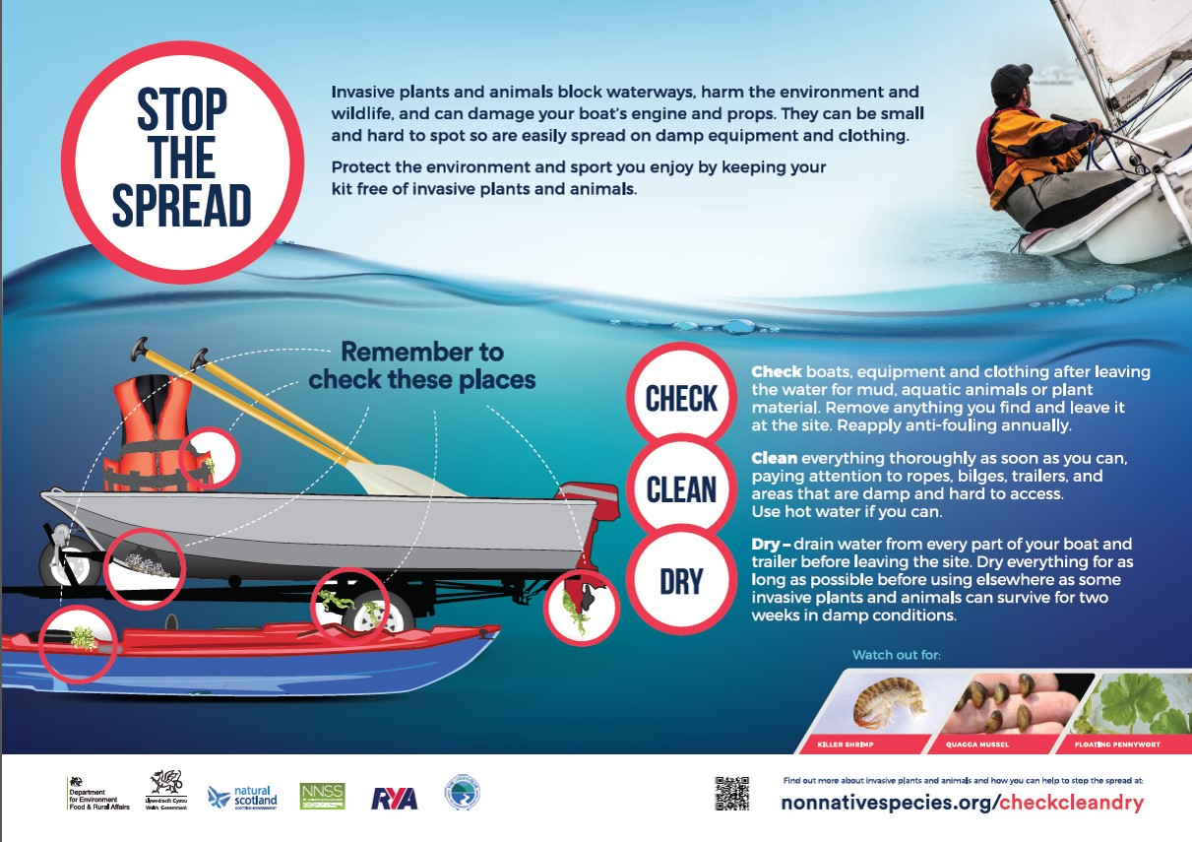
Check, Clean, Dry
Notes:
For participants the key is to give them enough warning to ensure they have time to clean their boats and kit effectively.
Ask all participants to ‘Check Clean Dry’ before they leave home (making sure all washdown and scraping material is disposed of appropriately). You could raise the issues through the relevant class association and you can also include guidance in the event paperwork – from when they register to inclusion in the rules of the day.

Slide 8
Economic Impact
£1.7bn overall
£100m in marine environment.
Likely to be a large under estimate.
Demonstrates the most impacted sectors.
‘Figures based on The Economic Cost of Invasive Non-Native Species on Great Britain, F. Williams, R. Eschen, A. Harris, D. Djeddour, C. Pratt, R.S. Shaw, S. Varia, J. Lamontagne-Godwin, S.E. Thomas, S.T. Murphy, CAB/001/09 November 2010’
Notes:
Invasive non-native species, also known as alien species, are, unfortunately, increasing across the UK, both in the sea and on the land, more than 10 per cent of Great Britain’s land area or coastline now has established populations of invasive species.
The cost of this to the mariculture and fishing sector is significant – estimates say that all INNS, on land and in the sea, cost the UK around £1.7bn with more than £100 million being attributed to their management in the marine environment, more than £7 million of this in the aquaculture sector. Most of this is down to increased costs associated with cleaning equipment and mortality of stock.
This is likely to be a significant underestimate as it does not include difficult to measure things such as the increased time it takes to clean an infested crab and lobster pots or to clean species such as the carpet sea-squirt Didemnum vexillium (you may know it as D vex) off shellfish.
But SO WHAT?!

Slide 9
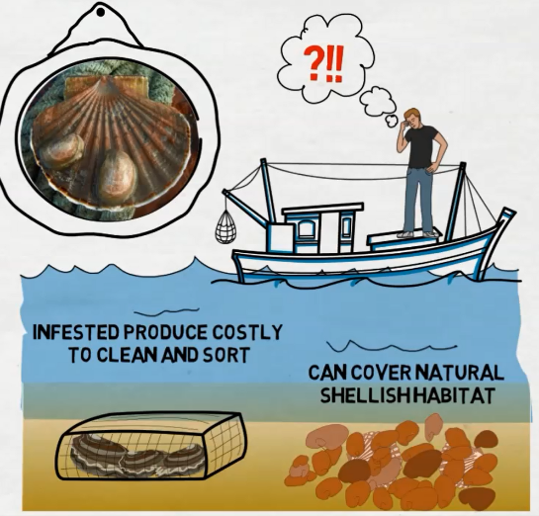
Crepidula fornicata on scallop shell © Rafael Bañón
Notes:
As a mariculture manager you will be starkly aware of the need for high levels of biosecurity. Your industry depends on clean stock, boats, nets and staff to ensure that pathogens are effectively controlled. And there are many daily checks undertaken and records kept to ensure that your site and business remains compliant.
Commercial fishermen will also be aware of the need to keep their boats and gear clean to lower fuel costs, minimise wear and tear and reduce safety risks.
The problem is that invasive species work against you and increase costs and risks, they also damage the natural environment that your business depends on.

Slide 10
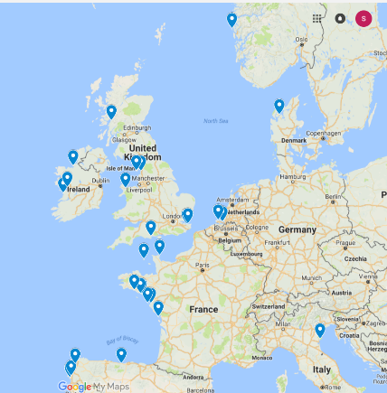
High Risk Imports?
Import of INNS is our primary concern but we can, and do, export INNS to other countries.
EU Shellfish Hatcheries
Notes:
Unfortunately your sectors have the potential to import INNS from far afield, you can see from the map the shellfish hatcheries which may be importing to the UK. The movement of kit and stock around the UK also helps invasives to spread when they do get here.
With new laws in place in many countries, you need to understand your responsibility to minimise the risk to your business from invasive non-native species.

Slide 11
Schedule 9
Chinese Mitten Crab Eriocheir sinensis
Slipper Limpet Crepidula fornicata
Giant Kelp Macrocystis angustifolia
Giant Kelp Macrocystis integrifolia
Giant Kelp Macrocystis laevis
Giant Kelp Macrocystis pyrifera
Japanese Kelp Laminaria japonica
Green Seafingers Codium fragile
Green Seafingers Codium fragile tomentosoides
Californian Red Seaweed Pikea californica
Hooked Asparagus Seaweed Asparagopsis armata
Japanese Seaweed Sargassum muticum
Laver Seaweeds (except native Porphyra species P. amethystea, P. leucosticte , P. linearis , P. miniata , P. purpurea & P. umbilicalis)
Wakame Undaria pinnatifida
BIOSECURITY PLAN
----------------------------------------------------------------------------------------------------------------------------------------------------------------------------------------
-----------------------
-----------------------
-----------------------
------------------------------------------------------------------------------------------------------------------------------------------
----------------------------------------------
Notes:
The law in the UK varies. In England and Wales The Wildlife and Countryside Act 1981, and its various amendments, is the most important piece of legislation dealing with INNS.
The Act makes it illegal to release, plant or allow to escape into the wild any animal or plant which is not ordinarily resident, or a regular visitor to Great Britain, or is listed in Schedule 9 of the Act.
Although you don’t need a marine biology degree – identification of the species listed under Schedule 9 is useful and appointing a biosecurity manager for your site will be helpful so that they can spend some time becoming familiar with problem species.
Setting aside the Pacific Oyster for now, the essence is that the principle of ‘polluter pays’ remains in force throughout the UK, you would be well advised to do what you can to protect yourself and your business.
You may also be aware of other pieces of legislation such as The Marine Strategy Framework Directive, the European Strategy for Invasive Alien Species, the EU Invasive Alien Species regulation or the European Water Framework Directive. There is also the 2004 International Convention for the Control and Management of Ships’ Ballast Water and Sediment and other various legal regulations and standards.

Slide 12
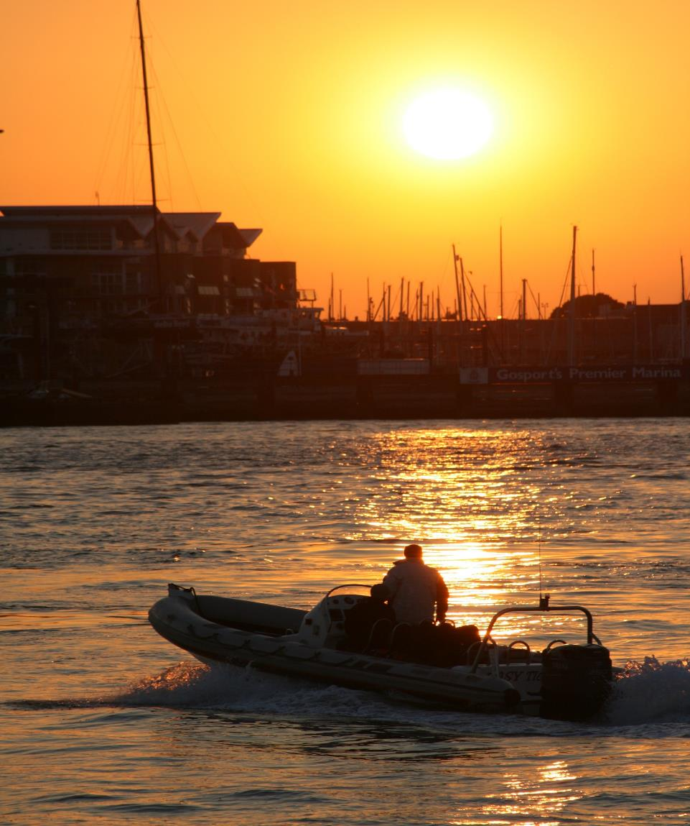
Drivers for Change
Legal Challenge
Public Expectation
Investor
Confidence
Stakeholder Expectation
Market Advantage
Risk Management
Planning
Restrictions
Legislation
Suppliers
Environmental
Damage
Customers
Reputation
Notes:
Other drivers for change include the consumers of your product, both the buying public and wholesalers or supermarkets are more interested in the heritage of a product these days and this includes the environment it comes from. Business partners will also want to see risks to their investments effectively managed.
The reputational gains from being a sustainable, INNS free, organisation are significant and investors will be pleased to see you taking steps to reduce your risk.
Most of all an area free from invasive species will function better and therefore your harvest will be better protected.
This all may seem complex and perhaps you feel, as a shellfish farmer in particular, that you are already compliant with a host of regulations, and we should say at this point that biosecurity planning for INNS is not a statutory requirement, however it is worthwhile investigating your existing systems to ensure that you are doing all that is practical to reduce your risk from INNS.
Avoiding the spread of INNS is not as difficult as you may at first suspect. Control of INNS is very difficult, particularly in the marine environment, and so the statutory agencies, such as Natural England, have avoided being too prescriptive about how to do it. Instead they request people ‘follow best practice’, mostly allowing users to define what is most appropriate for them.

Slide 13
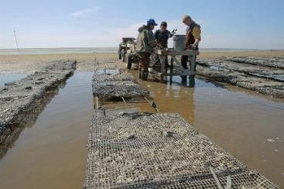
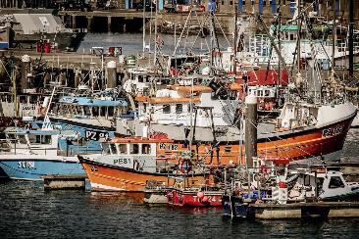
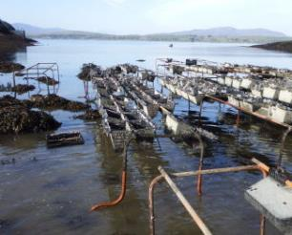
Remove unused items
Images courtesy of www.coastalnets.co.uk and www.fish2fork.com
Notes:
The essence of good biosecurity, that is reducing the likelihood of importing or spreading invasive species, is to identify the high-risk activities and then ensure that everyone plays their part in reducing the risk.
The high risk activities are for you to decide and will depend on the way you operate but they will most likely focus on where you import stock from, how you prepare stock for movement (if you send on stock for growing on, rather than for consumption), and how you manage your vessels including how often you scrub the hull and antifoul.
The low hanging fruit for mariculture managers and commercial fishermen include:
Where practical, remove man-made structures from the water when they are not in use. In general INNS prefer artificial structures and removing what you can is an easy to do basic biosecurity measure. This could include temporary removal out of the preferred growth zone for example, removal of any movable trestles or other structures such as old fenders, warps, keep nets, oyster bags etc.
If possible, have spare bags or creels and pots so they can be used in rotation and be cleaned and air dried to remove any fouling.

Slide 14
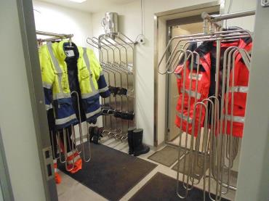
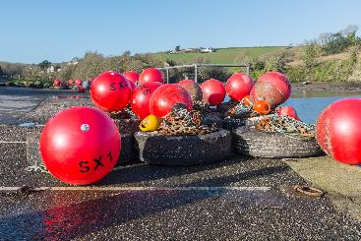
Dry what you can, when you can
Image courtesy of https://businessguide.offshoreenergytoday.com/profiles/view/pronomar_b_v
Nick Maslen / Alamy Stock Photo
Notes:
Air dry what you can, when you can. Most, if not all, marine and aquatic INNS are killed by dehydration. Identify opportunities to dry out equipment or infrastructure as often as possible. This could mean a drying room/area for dive kit, PPE, oyster bags etc.

Slide 15
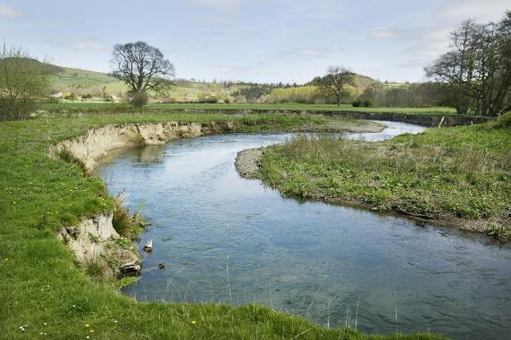
Use Freshwater Inputs
Image courtesy of http://www.geowestmidlands.org.uk/wiki/index.php5?title=File:River_Lugg_meanders.jpg
Notes:
Making the most of any natural flows of freshwater into your site can be helpful. This won’t work for every shellfish type or every site as either the animals won’t tolerate it or you won't have access to the water, however immersion into freshwater for a marine invasive can reduce the speed of its growth or even kill it and it can be a useful biosecurity measure for shellfish moving off an aquaculture site in particular. Marine INNS adhering to a boat hull will likewise be disadvantaged by being placed in a freshwater flow so mooring a work boat in the river outflow can be a useful way of minimising hull fouling.

Slide 16
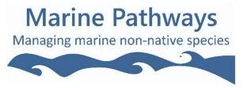
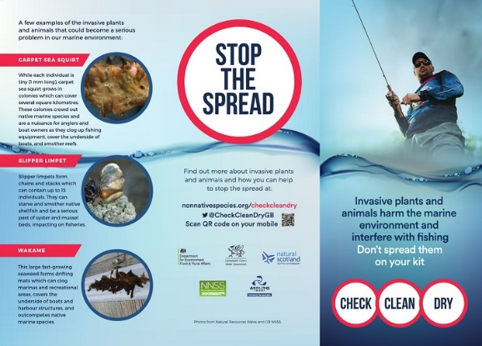
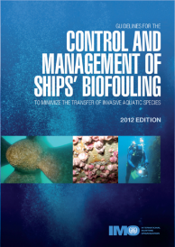
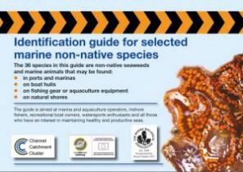
Communication Tools
Notes:
Raise awareness. Many people are unaware of marine INNS and the threats associated with them and raising awareness often empowers people to take action. Whilst it is not necessary to become a marine biologist, some idea of what to look out for gets people interested and increases effective reporting. There are plenty of free or low cost ID guides available on the web, including on the marine pathways website, or you could do your own, site specific guide. Train your staff to be alert to unusual growth in the marine environment including on shellfish and supporting structures. Place visual aids in mess rooms and offices to aid familiarity.

Slide 17
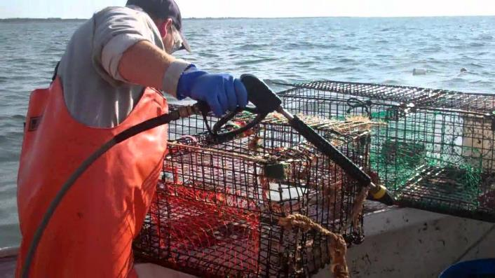
Washdown
Image courtesy of Capt. John's Bar https://www.youtube.com/watch?v=iQorpdWeFCM
Notes:
Mariculture, in particular, is a heavily regulated sector and, as we said earlier, many biosecurity actions will already be in place under measures designed to maintain stock health and pathogen control. However following best practice will further lower risks associated with INNS.
Remember that it is just as important to stop alien species arriving in the area as it is to stop INNS leaving the site or boat. To slow or halt the arrival of alien species ensure that any suppliers also take their share of the responsibilities. Write into your contract with them that you expect stock to be INNS free and that all kit, infrastructure, staff etc., will arrive clean and INNS free too.
Stopping INNS from leaving a site means checking your stock, kit, tractors/trailers, anchors and fishing gear for sediments and fragments of weed and sediment, and clean them off, preferably well away from the water’s edge, before they leave an area. Any raw water intakes for circulation around an onshore site, or vessel should also be filtered and treated before returning to the sea.
On the site it is important to have relevant cleaning facilitates set up for kit and vessels coming ashore – this will range from a simple fresh water wash down area, well away from the water’s edge, through to a full lift and scrub facility, or access to one, for larger vessels.
When doing routine inspection of boats for any structural problems also inspect them for obvious fouling. A quick look is enough to gauge the cleanliness of a boat. Look to see if there is more than a low level of hull slime at the water line. If there is it is time to clean.
Always reinforce the message that any concerns staff have can be escalated if necessary so that you can deal with them appropriately.

Slide 18
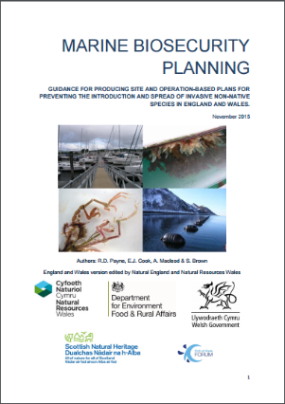
Understand your site
Understand how INNS are introduced to your site
List site activities
List biosecurity measure
Contingency, monitoring and surveillance
Notes:
So how does all this relate to the legislation we discussed earlier?
In essence, by undertaking a relevant set of biosecurity actions you are demonstrating ‘best practice’ and reducing the likelihood of introducing or spreading invasive species. By recording it all in one document – your biosecurity plan – you can show anyone who may have concerns about your activities that you are taking all reasonable steps to lower the risk of introducing or spreading invasive non-native species.
Biosecurity Planning
You can take these actions to their logical conclusion and do a full biosecurity plan for your business. This involves a five step process. Templates and examples are available on the website to help you.

Slide 19
Writing your Plan
Section 1 - Introduction
Why are you writing a biosecurity plan?
What are the major concerns for our business?
BIOSECURITY PLAN
----------------------------------------------------------------------------------------------------------------------------------------------------------------------------------------
-----------------------
-----------------------
-----------------------
------------------------------------------------------------------------------------------------------------------------------------------
----------------------------------------------
Notes:
Section 1 – Introduction
Your opening section sets the scene for why you are doing a biosecurity plan and what the major concerns are for your business. For example, you may be concerned about effects on the environment and legal or reputational impacts.

Slide 20
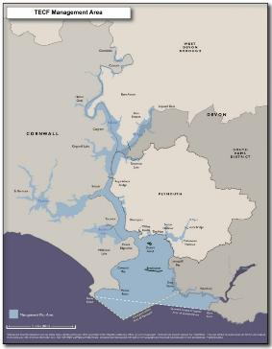
Section 2 – Scene Setting
Identify the area covered by the plan
Geographical scope
Time limits
Activities
Useful contacts
Local Natural England staff
Relevant experts, marine biologists, biosecurity experts, university contacts etc.
Fig 1: TECF Management Area
CHOOSE AN IMAGE RELEVANT TO YOUR AUDIENCE
Notes:
Section 2 – Scene Setting
Here you identify what geographical area or activity is to be covered by the plan. This section should also outline support from senior management and identify a member of staff who is responsible for enacting and updating the Plan.
(examples from the Tamar Estuary Biosecurity Plan) : http://web.plymouth.gov.uk/tecf

Slide 21
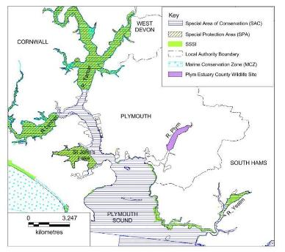
Section 3 – Environmental Information
Physical structure and layout of the site
Water chemistry, temperature and other relevant data
Lists of INNS known to be present or on the horizon
Existing designations e.g. SSSI or MCZ etc.
CHOOSE AN IMAGE RELEVANT TO YOUR AUDIENCE
Notes:
Section 3 - Environmental Information
In this section you should delve into more detail about the physical characteristics of the area covered by the Plan. Gather as much information as you can about the chemistry of the waters local to your business. Salinity and temperature information can often be found online, or your company may already record it as part of their normal business. By comparing this data to the known preferences of invasives species, found on the GB non-native species secretariat website, will narrow down your list of species of concern.
Details of species thought to be on their way here as well as those known to have already arrived are also listed on the website. You may already have records of invasive species locally and these should be examined and included in your assessment.
Also find out about any existing management arrangements for example, is the area a SSSI (Site of Special Scientific Interest) or have other protected status such as an MCZ (Marine Conservation Zone)? If so contact Natural England to find out more about INNS and current management of marine protected areas locally.
Map: http://web.plymouth.gov.uk/tecf

Slide 22
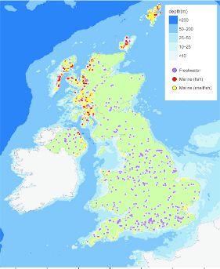
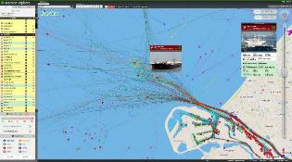
Section 4 – Use of the Area
Major types of activity
How many boats? What type of stock?
What type of boat? Ballast water used?
Where are they coming from?
UK shell and finfish farm sites. © S Brown
Notes:
Section 4 - Use of the Area
Here you will list the major types of activity you expect in the area.
How many boats, where are they coming from, what type of boats are they, do they contain ballast water? Can you identify activities which are at highest risk of importing invasives species to your site?
What sort of stock movements are common and what INNS could move with them? What are the highest risk activities?
Again more information is available on the GB Secretariat website, links at the end.
Left image from marine traffic

Slide 23
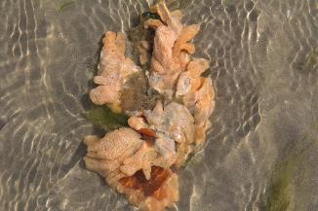
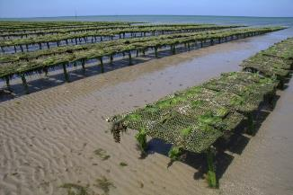
Stock movement
Stock movement is probably one of the highest risk activities on a shellfish site and several INNS have been imported into and around the UK, unknowingly, on stock.
Carpet Sea-squirt Didemnum vexillum on a shellfish farm in France.
Images courtesy of Dr Rohan Holt, CloudBase Productions Ltd
Notes:
(The images here show the oyster trestles in Normandy and a piece of Carpet Sea-squirt (Didemnum vexillum) in the water adjacent to the site making the point that the stock looks clean but is likely to host INNS.)

Slide 24
Section 5 – Biosecurity Actions
Communications and Reporting
Establish a point of contact for INNS with Natural England
Encourage an open culture of reporting unusual sightings.
Allow ‘open access’ recording of INNS by researchers.
Seek opportunities to work in partnership with research organisations or conservation groups to improve monitoring, training and reporting.
Refer to your local IFCA for best practice advice - see Association of Inshore Fisheries Conservation Authorities for links.
Talk to the Shellfish Association of Great Britain for the relevant, best practice and advice.
Refer to Marine Pathways leaflet for more ideas.
Notes:
Section 5 - Biosecurity Actions / Control measures
Perhaps the most important section. Here you outline the actions you plan to take to improve your biosecurity. These should be based on what we discussed earlier, but the final list will vary depending upon the activities and people involved and the risk associated with. Aim to stay practical – the INNS information for the shellfish aquaculture industry published by Natural England in 2015 includes some useful suggestions for actions.
On the last slide there is an email address for reporting sightings.
(READ ACTIONS FROM SLIDES AS TIME ALLOWS)
(EDIT SLIDES TO AUDIENCE AND TIME)

Slide 25
Section 5 – Biosecurity Actions
Boat and Kit Cleanliness
Identify any high-risk activities and decide on relevant actions. For example completing a survey for INNS before movement of shellfish off site.
Always either wash down equipment into the same water body or wash down well away from the water’s edge.
Use the best antifoul coatings for your boat and type of use.
If not in use, and you have a muddy seabed, drop your mooring in winter to smother any fouling which has accumulated through the season (attach a riser for easy retrieval).
BIOSECURITY PLAN
----------------------------------------------------------------------------------------------------------------------------------------------------------------------------------------
-----------------------
-----------------------
-----------------------
------------------------------------------------------------------------------------------------------------------------------------------
----------------------------------------------
Notes:
(High risk activities vary – import of new stock is top of the list, heavy fouling on boats and equipment is another example)
(NB this is a simplified list – more actions available on the website)
(Good to emphasise = residues from wash down may include live material along with antifouling paint flakes and solutions. )

Slide 26
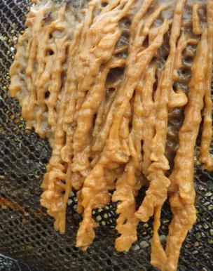
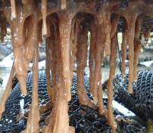
Loch Creran Case Study
Pendulous growth form of Carpet Sea Squirt Didemnum vexillum
© Dr D Minchin, Marine Organism Investigations
Notes:
You may have been listening to all this and thinking ‘but does anyone really DO this?’. Let me give you a short case study before we have a chance for questions.
The discovery, in 2014, of the invasive carpet sea-squirt Didemnum vexillum in Loch Creran on the west coast of Scotland was a blow to the local community including the commercial fisherman, the many oyster farms, the fin fish farm and the fish processing plant in the Loch. Scottish Natural Heritage and Marine Scotland, who are responsible for management of the fisheries and the protected biogenic reefs in the Loch, were also significantly concerned about the short and long term impacts.

Slide 27
Aims of the Loch Creran Plan
Help control D. vexillum
Help to contain D. vexillum
Help to avoid more introductions
Develop relevant and practical actions and monitoring
Help support local stakeholders
Help to raise awareness and increase reporting
Notes:
The local economy revolves around this busy Loch with marine recreation, tourism, commercial shipping and aquaculture businesses all heavily invested in the area. Marine Scotland took the lead and decided to use the new powers available to them under the Wildlife and Natural Environment (Scotland) Act to introduce a Species Control Order (SCO) to help manage the outbreak.
Parallel to the Species Control Order, and in order to ensure that all residents and users played their part in the biosecurity actions, a local contractor was taken on to assist with the development of a Loch wide biosecurity plan. Further information including a poster and sector specific information for shellfish growers was developed.

Slide 28
Developing the Loch Creran Plan
Stakeholder Mapping
1-2-1 discussions
Risk Assessment
Development of Actions
Development of Monitoring Regime
Agree Actions and Monitoring
Awareness Raising
Support for implementation
Notes:
The process of developing the plan was relatively simple and involved meeting all key stakeholders one to one, including mariculture and fishing interests, and discussing what would be possible in terms of biosecurity actions for their site or activity, recording this and then developing a monitoring programme to check the effectiveness of the plan.

Slide 29
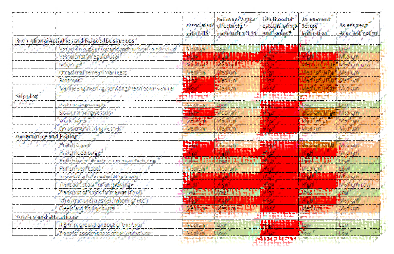
Risk Assessment
Likelihood of establishment and spread
Effectiveness of vector
Risk
Vector association with NNS
Notes:
Then a risk assessment needed to be done
Because a high risk INNS was already in the Loch it immediately flagged everything as being RED!!!!!
It was felt that the full risk assessment could lead to a blame game so was not included in the final plan.
You will see it is blurred it out here for the same reason

Slide 30
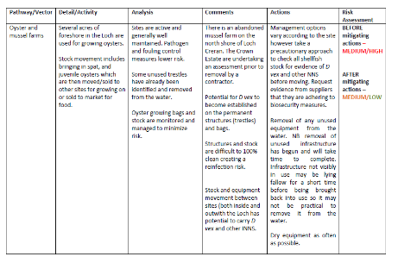
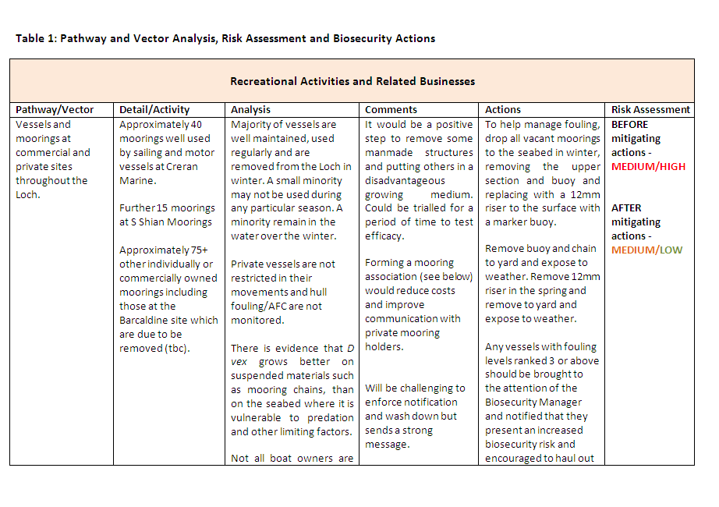
Development of Actions
Notes:
Examples of actions for shellfish farming and shipping

Slide 31
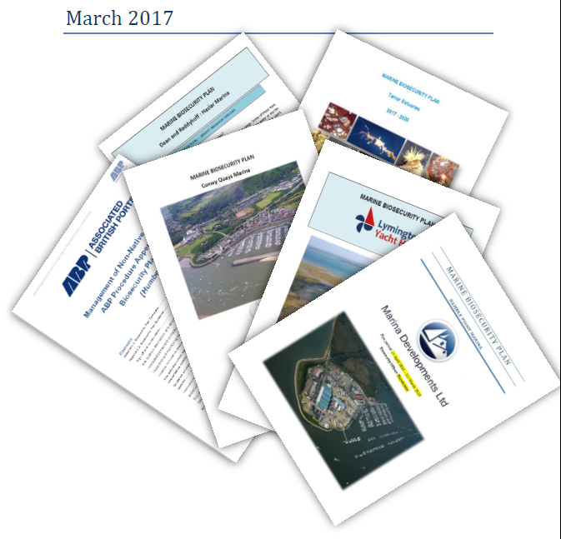
Loch Creran is not alone – biosecurity planning across the UK
Notes:
To date the Didemnum has not spread from the initial infection site and, thanks to ongoing engagement, local stakeholders continue to report suspected sightings and undertake their biosecurity actions.
So, as you can see, biosecurity planning can be relatively easy to achieve and can protect you and your business from possible reputational and legal risks.

Slide 32
Contacts
Report INNS sightings by using iRecord (https://www.brc.ac.uk/irecord/ or the iRecord app) or by emailing alertnonnative@ceh.ac.uk
GB Non-Native Species Secretariat www.nonnativespecies.org
National Biodiversity Network – Distribution maps and information www.nbnatlas.org
RAPID LIFE: www.nonnativespecies.org/rapid
Notes:
I’d welcome any questions and if I can’t answer any of them I promise to make a note and get back to you with answers as soon as possible.

Slide 33
Thank you for listening Any questions?
Slides prepared by Sarah Brown, sarah@c2w.org.uk

