Slide 1
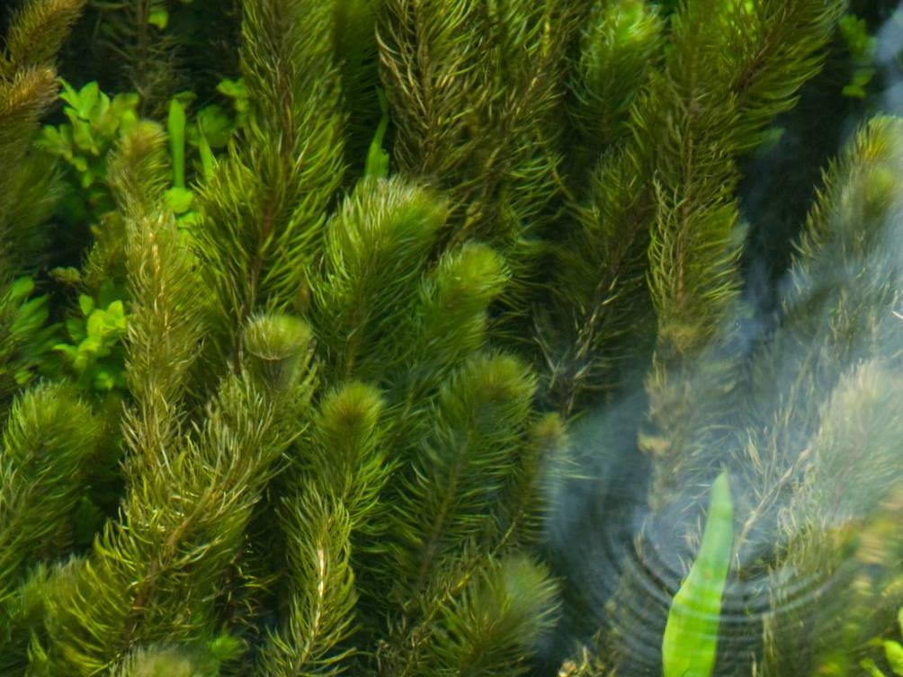
FRESHWATER INVASIVE NON-NATIVE SPECIES
Name of presenter

Slide 2
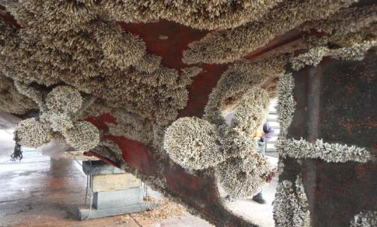
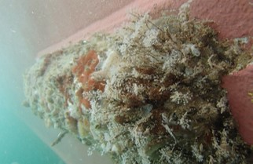
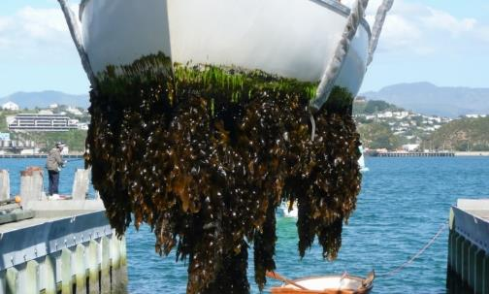
Freshwater Invasive Non-Native Species
Impacts on Marina and Boat Club Managers and Practical Biosecurity Steps
Hull fouling banner Images Ficopomatus enigmaticus, © R Holland; Hull fouling, © Copyright 2018 International Maritime Organization (IMO); Undaria pinnatifida on a boat hull, © Lesley Patston, MPI

Slide 3
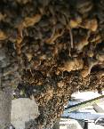
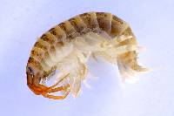
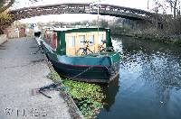
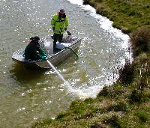
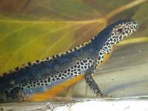
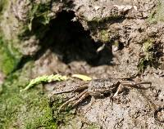
What are Non-Native Species?
Non-Native Species (NNS) are outside their normal / native range because of people.
Non-native Species becoming a problem are called ‘invasive’ (INNS).
NNS can also be called ‘non-indigenous’ or ‘alien’ species (IAS: Invasive Alien Species)
Images: Alpine newt © Anevrisme; Hydroctyle ranunculoides weed extraction boat, Crown Copyright 2009; Rotenone application © Matt Brazier, Environment Angency; Killer shrimp © Environment Agency; Mitten crab © GB NNSS, Zebra mussels © Crown Copyright 2009;
Notes:
I’m going to talk to you today/tonight about the threat from invasive non-native species, or INNS, in the freshwater environment and what we can do about it. I have a presentation which will take about half an hour which I hope will give you a useful insight into the world of invasive non-native species. I am happy to take questions at the end.
By the end of this short presentation I hope I will have given you not only a useful insight into the world of invasive species but also shown you that there are many actions we can all take to reduce the risk of their spread and reduce the impact of their growth.

Slide 4
Notes:
Link to video on YouTube. Requires web access and can take a minute to load and play.
Here is the link in case the one within the Powerpoint doesn’t work: https://www.youtube.com/watch?v=EoggtzYr4Qk

Slide 5
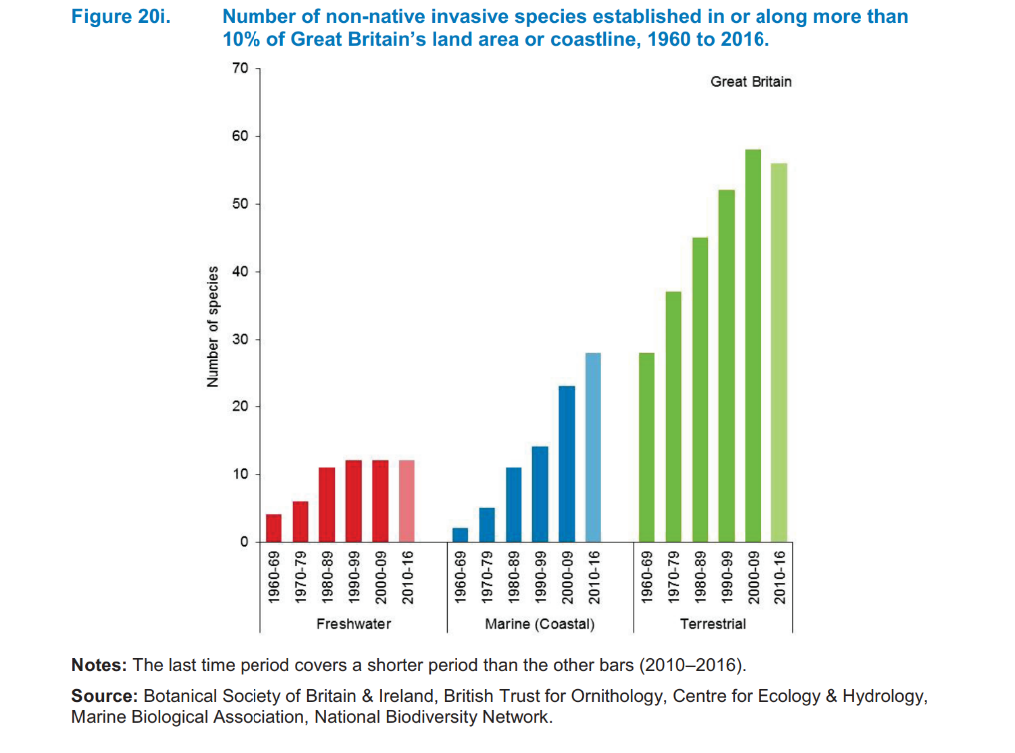
Ever Increasing Invasives
Notes:
Invasive non-native species are becoming more prevalent, becoming established in or along more than 10 per cent of Great Britain’s land area or coastline, increasing the pressure on native biodiversity.

Slide 6
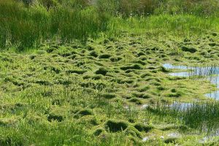
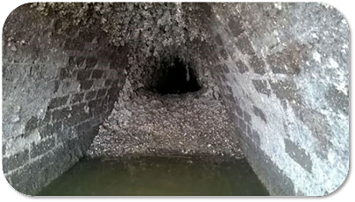
Economic Impact
£1.7bn cost to British economy annually
Likely to be a large under estimate
At least £23 million annually for 7 freshwater invasive plants
Annual cost of zebra mussels to industry in North America is estimated to be $5 billion and numbers are expanding in UK
Early eradication of water primrose would cost £73 thousand compared to £242 million that it would likely cost if fully established as in France and Belgium
‘Figures based on The Economic Cost of Invasive Non-Native Species on Great Britain, F. Williams, R. Eschen, A. Harris, D. Djeddour, C. Pratt, R.S. Shaw, S. Varia, J. Lamontagne-Godwin, S.E. Thomas, S.T. Murphy, CAB/001/09 November 2010’
Notes:
The estimated cost across the Great Britain is £1.7 billion; big impacts in freshwater habitats.
But SO WHAT?!
Photos: crassula, Benjamin Blondel; zebra mussels in water pipe, Thames Water; used with permission

Slide 7
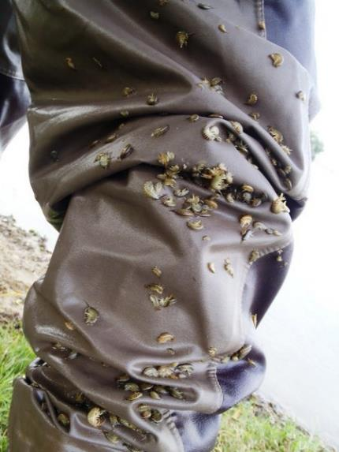
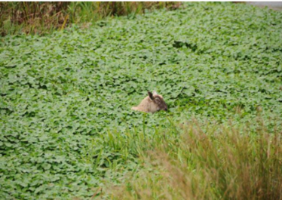
But SO WHAT?!
Notes:
Invasive species have many serious impacts. For example, floating pennywort forms dense interwoven mats with stem growth rates of up to 20cm per day. It can regrow from seeds or roots and even a single node fragment, and is resistant to chemical control. It has over-run many water bodies already, changing availability of oxygen in the water, threatening fish and invertebrates, choking drainage systems and crowding out native water plants. Costs linked to management and the impact on tourism and recreation are estimated to exceed £25 million per year.
“Killer shrimp” (Dikerogammarus villosus) are aggressive hunters, predating damselflies, small fish, and native freshwater shrimp and altering the food chain in freshwater habitats,. They are regarded as one of the most damaging invasive species in Western Europe. Trout and perch feed on killer shrimp, which could drive changes in distribution of fish and catchability for anglers. The shrimp may also serve as an intermediate host for parasites that affect salmon. They can survive for several days in damp conditions on waders or keep nets and can spread 124 km per year downstream and 40 km per year upstream. Spread has been facilitated by boating and angling; D. villosus fouls surfaces such as engines and anchors and can be carried in water in hulls, trailers, etc. They are currently established in three reservoir habitats in Britain.
Photos: sheep in floating pennywort, Trevor Renals; killer shrimp, http://bbn.firetrench.com/2012/09/protect-the-trinity-broads-against-the-killer-shrimp/

Slide 8
Members Expectations
Fishing byelaws and rod licenses
Market Advantage
Invasive Alien Species regulation
pathways action plans
Legislation
European Water Framework Directive (WFD)
Legal Challenge
Listed species
European Strategy for Invasive Alien Species
EU Invasive Alien Species regulation
Schedule 9
Wildlife and Countryside Act 1981
Environmental
Damage
Risk Management
Notes:
As a marina manager, you will be aware of the amount of regulation that surrounds your sector including health and safety, licencing and planning, not to mention demands from customers and business partners who wish to see risks managed. The reputational gains from being a sustainable, INNS free, organisation are significant and most investors will expect to see you taking steps to reduce your risk.
Marina management depends on the many daily checks undertaken and records kept to ensure regulations are adhered to.
However what may be new to you is that with new laws in place in many countries, you need to understand your responsibility to minimise the risk to your business from invasive non-native species.
The law in the UK varies across the different administrations. In England The Wildlife and Countryside Act 1981, and its various amendments, is the most important piece of legislation dealing with INNS.
You may also be aware of other pieces of legislation such as The European Strategy for Invasive Alien Species, the EU Invasive Alien Species regulation or the European Water Framework Directive.

Slide 9
Schedule 9 example species
Chinese Mitten Crab Eriocheir sinensis
Large-mouthed Black Bass Micropterus salmoides
Rock Bass Ambloplites rupestris
Bitterling Rhodeus sericeus
Noble Crayfish Astacus astacus
Signal Crayfish Pacifastacus leniusculus
Turkish Crayfish Astacus leptodactylus
American Mink Mustela vison
Alpine Newt Triturus alpestris
Italian Crested Newt Triturus carnifex
Pumpkinseed (Pond perch) Lepomis gibbosus
Wels (European catfish) Silurus glanis
Zander Stizostedion lucioperca
BIOSECURITY PLAN
----------------------------------------------------------------------------------------------------------------------------------------------------------------------------------------
-----------------------
-----------------------
-----------------------
------------------------------------------------------------------------------------------------------------------------------------------
----------------------------------------------
Notes:
The law in the UK varies. In England The Wildlife and Countryside Act 1981, and its various amendments, is the most important piece of legislation dealing with INNS.
The Act makes it illegal to release, plant or allow to escape into the wild any animal or plant which is not ordinarily resident, or a regular visitor to Great Britain, or is listed in Schedule 9 of the Act. Don’t worry too much about lists – getting caught up in identifying every species can be a fascinating, but lengthy, distraction!
You may also be aware of other pieces of legislation such as The European Strategy for Invasive Alien Species, the EU Invasive Alien Species regulation or the European Water Framework Directive.
The key thing to remember is that throughout the UK the principle of ‘polluter pays’ remains in force. Should the introduction of an invasive non-native species be attributed to your event there is the potential for you to be held accountable for the clean-up.

Slide 10
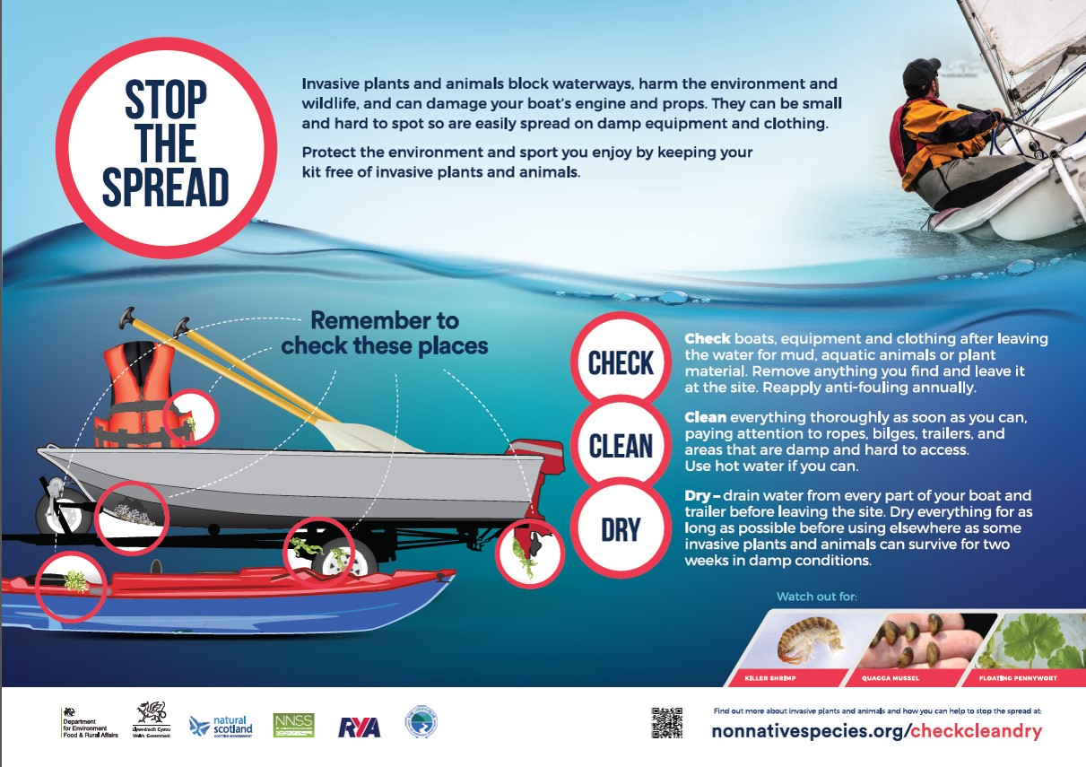
Check, Clean, Dry
Notes:
Avoiding the spread of INNS, and therefore prosecution, is not as difficult as you may at first suspect. Control of INNS can be very difficult so legislators have avoided being too prescriptive about how to do it. Instead they request people ‘follow best practice’, mostly allowing users to define what is most appropriate for them.
The essence of good biosecurity is to identify the low hanging fruit and the high-risk activities and then ensure that everyone plays their part in reducing the risk.
Most aquatic INNS are killed by dehydration. Identify opportunities to dry out equipment or infrastructure as often as possible. Where practical, remove man-made structures from the water when they are not in use. In general INNS prefer artificial structures and removing what you can is an easy to do basic biosecurity measure. This could include temporary removal of items such as mooring buoys or dredgers in winter.
One of the most effective actions to combat spread of INNS is to make sure all users follow the “Check, Clean, Dry” recommendations. Post signs and provide informational leaflets which can be downloaded from the GB NNSS website.

Slide 11
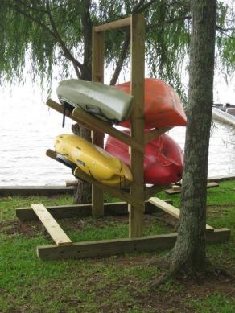
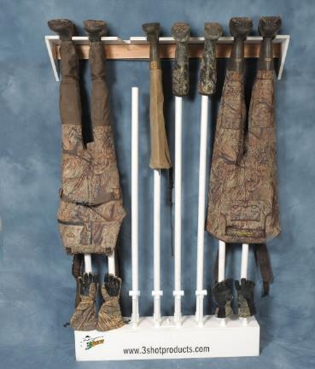
Drying racks
Provide drying racks near entry and exit points
Install racks and a dehumidifier in an indoor room for wet suits, waders and boots
Post “Check, Clean, Dry” information in these areas
Notes:
Consider installing racks for people to drain and dry equipment. This could be near the entry and exit access points for canoes, or in a small room in a clubhouse or bait store for PPE, waders or boots. Inside, consider installing a dehumidifier which will speed up drying considerably.
Photo credits: Photo © Gander Mountain Gear; Photo ©jaxkayakfishing.com

Slide 12
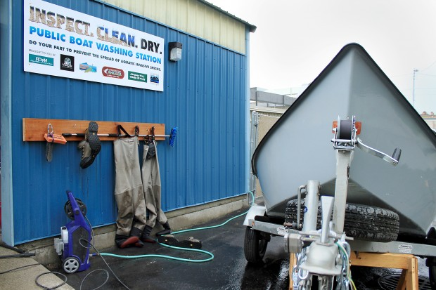
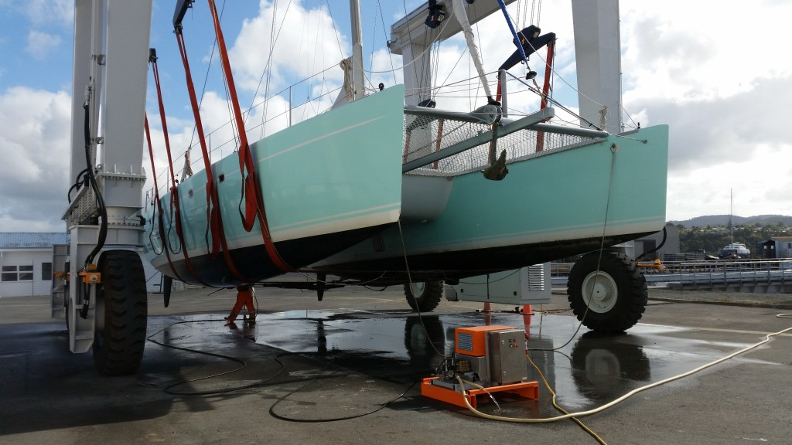
Cleaning/washing stations
On the site, wherever possible you should have cleaning/washing facilities
Appropriate scale for the site
Well away from the water’s edge
Appropriate drainage and disposal
Notes:
On the site it is important to have relevant boat cleaning facilities set up – this could be a simple wash down area, well away from the water’s edge through to a full lift and scrub facility or dry dock, for larger vessels.
Images: Sail Catamaran on Washdown Pad at Port Whangarei Marine Centre © http://portwhangarei.com; public washing station © Copyright https://www.umowa.org/articles/2018/4/6/umowa-boat-washing-station
(Good to emphasise = residues from wash down may include live material along with cleaning solutions. Runoff should drain into foul sewer. )

Slide 13
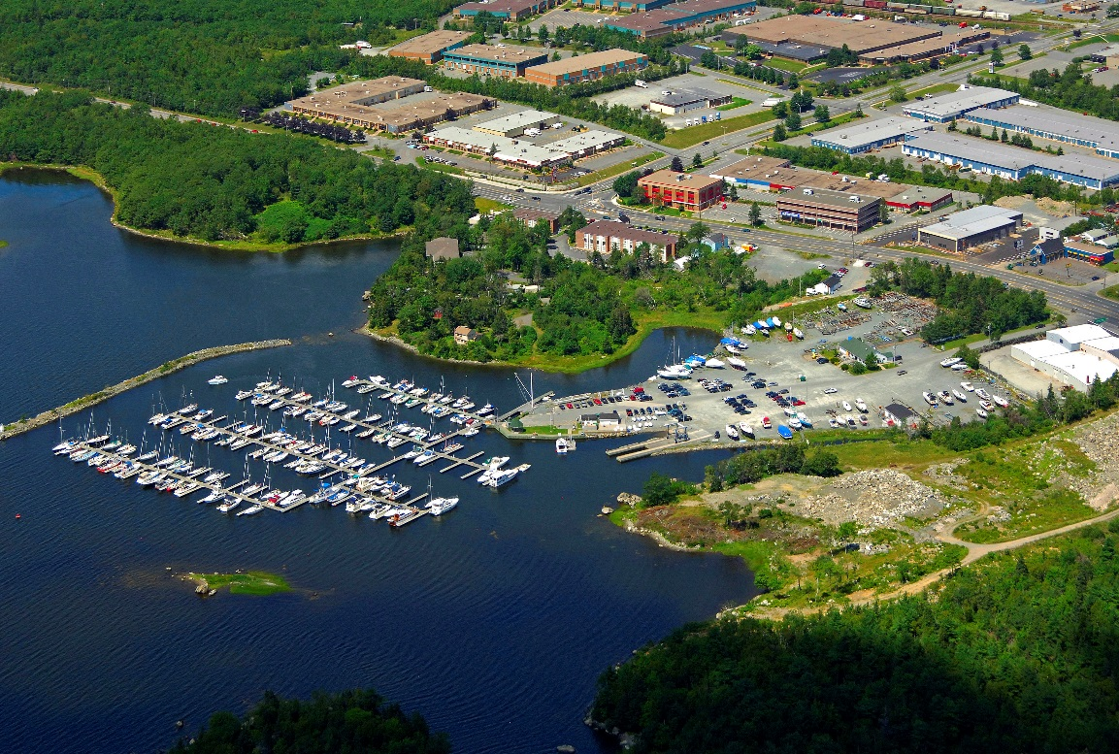
Boats arriving from marine environments
Notes:
Marine INNS need some degree of salinity to sustain their life cycle. If boats are arriving from marine environments, expose them to fresh water through immersion or wash down.
Image source: https://marinas.com/view/marina/ywcdry_Dartmouth_Yacht_Club_Marina_Dartmouth_NS_Canada

Slide 14
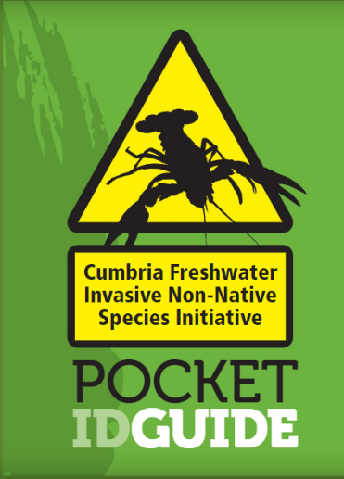
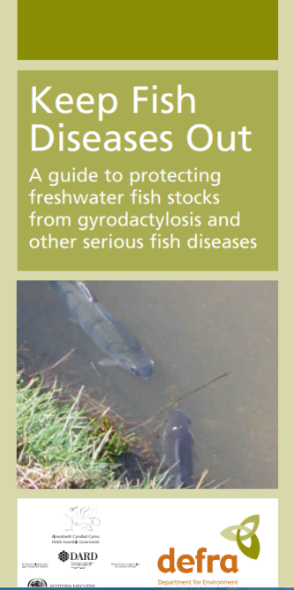
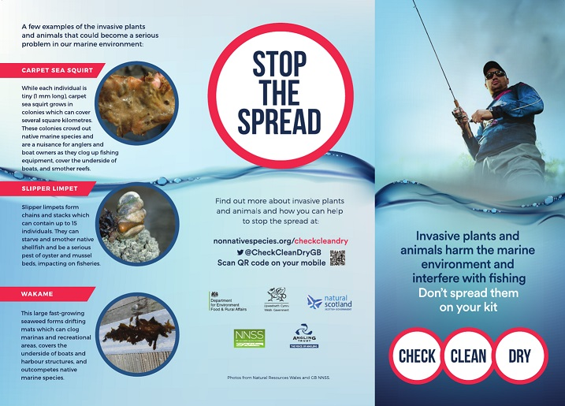
Raise awareness
Notes:
Raise awareness. Many people, including many of your staff, are unaware of INNS and the threats associated with them. Raising awareness often empowers people to take action. Whilst it is not necessary to become a biologist, some idea of what to look out for gets people interested and increases effective reporting. There are plenty of free or low cost ID guides available on the web or you could do your own, site specific guide. Train your staff to be alert to unusual organisms in the environment and get them to look out for it when undertaking routine visual inspections of infrastructure and vessels. Place visual aids in mess rooms and offices to aid familiarity.
So how does all this relate to the legislation we discussed earlier?
In essence, by undertaking these actions you are demonstrating ‘best practice’. By recording it all in one document – a biosecurity plan – you can show anyone who may have concerns about your activities that you are taking all reasonable steps to lower the risk of introducing or spreading invasive non-native species.

Slide 15
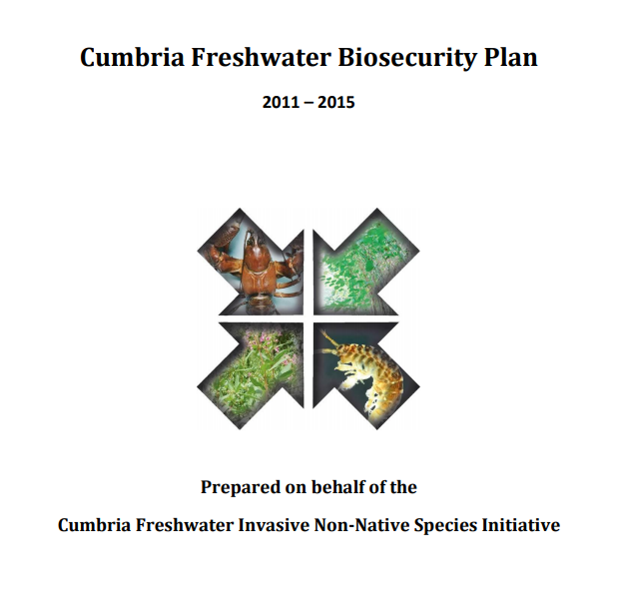
Biosecurity Planning
Notes:
Preventative Medicine
So how does all this relate to the legislation we discussed earlier?
In essence, by undertaking these actions you are demonstrating ‘best practice’. By recording it all in one document – your biosecurity plan – you can show anyone who may have concerns about your activities that you are taking all reasonable steps to lower the risk of the event introducing or spreading invasive non-native species.
Biosecurity Planning
You can take this one step further and do a full biosecurity plan for your event. This involves a five step process. Templates and examples are available on the website.

Slide 16
Section 1 - Introduction
Why are you writing a biosecurity plan?
What are the major concerns for our business?
BIOSECURITY PLAN
----------------------------------------------------------------------------------------------------------------------------------------------------------------------------------------
-----------------------
-----------------------
-----------------------
------------------------------------------------------------------------------------------------------------------------------------------
----------------------------------------------
Notes:
Step 1 – Introduction
Your opening section sets the scene for why you are doing a biosecurity plan and what the major concerns are for your site. For example, you may be concerned about effects on the environment and legal or reputational impacts.

Slide 17
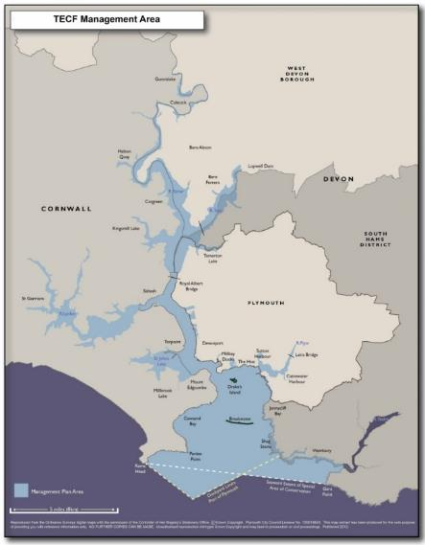
Section 2 – Scene Setting
Background to the plan
Geographical scope
Time limits of plan
Review schedule and updates
Activities
Useful contacts
Local Natural England staff
Relevant experts, freshwater biologists, biosecurity experts, university contacts etc.
Fig 1: TECF Management Area
Notes:
Step 2 – Scene Setting
Here you identify what geographical area or activity is to be covered by the plan, who has responsibility for the Plan and how and when it will be reviewed and updated. It is important to designate a person to be responsible for updating the plan.

Slide 18
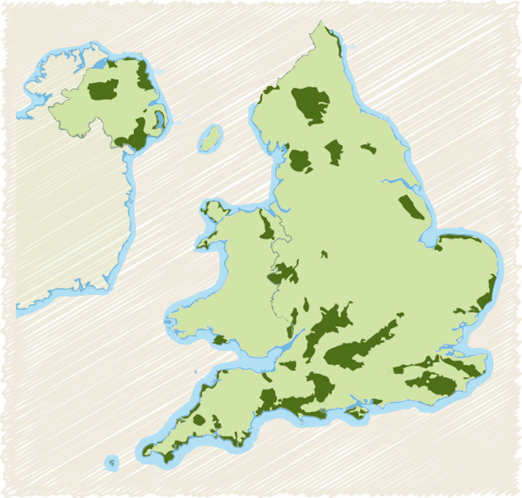
Section 3 – Environmental Information
Physical structure and layout of the site
Water flow, temperature and other relevant data
Lists of INNS known to be present or on the horizon
Existing designations e.g. SSSI or AONB, etc.
Areas of Outstanding Natural Beauty (AONBs) http://www.landscapesforlife.org.uk/about-aonbs/visit-aonbs/
Notes:
Step 3 - Environmental Information
In this section you should delve into more detail about the physical characteristics of the area covered by the Plan. Gather as much information as you can about the waters local to your event – this will give you a much better idea about the risk from invasive species. For example if the water is an area with little inflow and outflow, such as a lake, the biosecurity risk for spreading downstream may be less and more easily controlled. Also find out about any existing management arrangements for example, is the area a SSSI (Site of Special Scientific Interest) or have other protected status such as an AONB (Area of Outstanding Natural Beauty)? If so contact Natural England to find out more about INNS and current management of freshwater protected areas locally.
Also have a look at the known, and anticipated invasive species in the area – this will help with prioritising actions as well as identification.

Slide 19
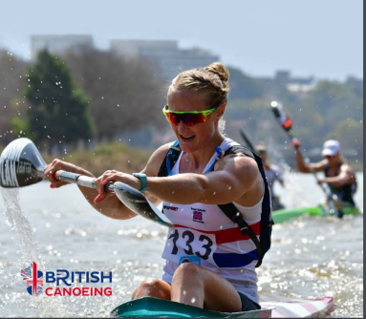
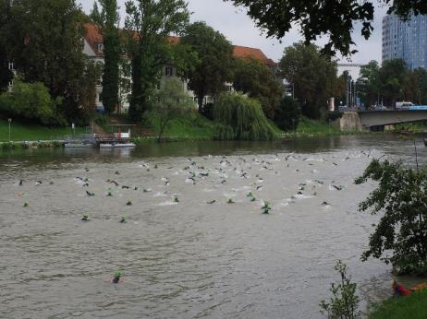
Section 4 – Use of the Area
Major types of activity
How many users?
What do they bring and what do they take away?
Where are they coming from?
Are they coming from another water body?
Notes:
Step 4 - Use of the Area
Here you will list the major types of activity you expect at the site. For instance, how many boats would you expect, where are they coming from? Would any of them have recently been in another water body? Do you have anglers?
(images from British Canoeing and AJ Shroetlin | Creative Commons)

Slide 20
Working with Contractors
Share responsibility by taking opportunities to write biosecurity expectations into contracts.
For example:
The contractor must submit a Biosecurity Risk Assessment for written approval at least 6 weeks prior to commencement of the works.
The contractor must ensure that all equipment, materials, machinery and PPE used are in a clean condition prior to their arrival on site to minimise risk of introducing INNS into the aquatic environment.
Notes:
From time to time you may employ external contractors to do some work at your club. Perhaps you will be having the boat docks serviced or installing pontoons. With professional contractors it is important to write your expectations into your agreement with them from the beginning.
Some examples are:
The contractor must submit a Biosecurity Risk Assessment for written approval at least 6 weeks prior to commencement of work.
The contractor must ensure that all equipment, materials, machinery and PPE used are new or are thoroughly cleaned prior to their arrival on site.

Slide 21
Section 5 – Biosecurity Actions
Encourage users to arrive and depart with clean, dry equipment.
Always wash down well away from the water’s edge to ensure that no residues can return to the water body.
Check all relevant tenants or contractors are aware of the need for clean vessels and equipment
Encourage reporting of unusual sightings.
Designate a Biosecurity Officer.
Notes:
Step 5 - Biosecurity Actions / Control measures
Perhaps the most important section. Here you outline the actions you plan to take to improve your biosecurity. We’ve discussed some of these actions already and what you choose to do will vary depending upon the activities and partners involved and the risk associated with the activities and the site. Aim to stay practical – you can always include a ‘wish list’ of other actions should time and budget allow.

Slide 22
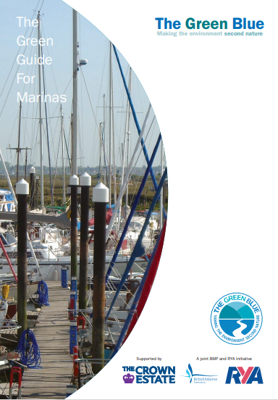
Examples and advice
Notes:
You may have been listening to all this and thinking ‘but does anyone really DO this?’. The answer is definitely yes. To give one example:
The Cumbria Freshwater Non-Native Species Initiative (CFINNS) worked with The Rivers Trust, Natural England, and the Environment Agency to develop the Cumbria Freshwater Biosecurity Plan. The plan works with local groups to address Cumbria’s freshwater and riparian biosecurity issues. CFINNS also offers advice to assist organisations in biosecurity planning and produce individually tailored freshwater biosecurity plans which can be both organisation and site specific.
Practical actions you can take include the actions discussed here: disseminating best practice to customers by making Check, Clean, Dry or The Green Blue materials available to people and promoting them, checking kit regularly, removing extra equipment from the water and training staff on identification and reporting.
You can also find examples of biosecurity plans on the GB NNSS site.
So, as you can see, biosecurity planning can be relatively easy to achieve and can protect you and your business from possible reputational and legal risks.

Slide 23
Contacts
Report INNS sightings by using iRecord https://www.brc.ac.uk/irecord/ or the iRecord app or by emailing alertnonnative@ceh.ac.uk
GB Non-Native Species Secretariat www.nonnativespecies.org
National Biodiversity Network – Distribution maps and information www.nbnatlas.org
RAPID LIFE: www.nonnativespecies.org/rapid
Notes:
I’d welcome any questions and if I can’t answer any of them I promise to make a note and get back to you with answers as soon as possible.

