Slide 1
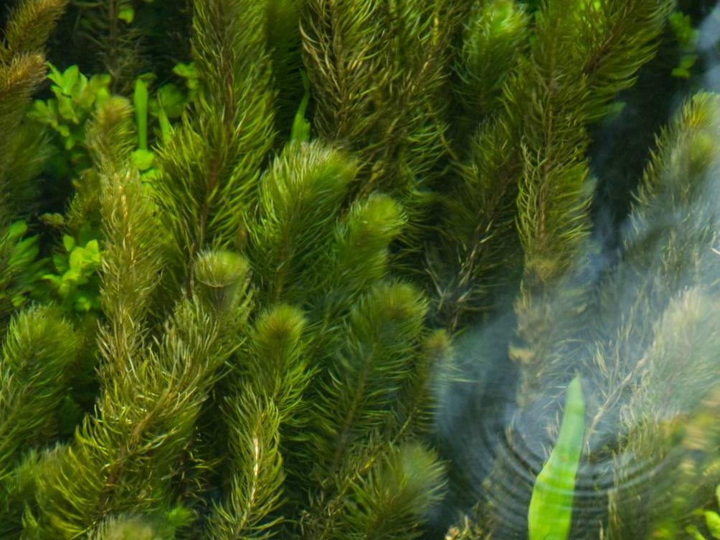
Shrimps, Bivalves and Fish: ID and Impacts
Name of presenter

Slide 2
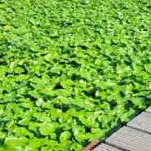
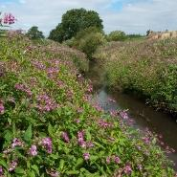
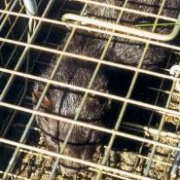
This presentation will cover the following invasive non-native species (INNS):
Killer Shrimp
Quagga Mussel
Round Goby
Fathead Minnow
Topmouth Gudgeon
Crayfish species
Carpet Sea-squirt
American Lobster

Slide 3
Why these species?
These species are considered to be:
Highly likely to either become invasive in the UK or continue to spread rapidly if not controlled.
A serious threat to native species of flora and fauna.
A serious threat to economic interests e.g. aquaculture.
Similar to other species that pose a threat.
Notes:
What are priority species?
Highly likely to become invasive in UK e.g. species that have spread rapidly and are thriving in Europe.
A serious threat to native flora and fauna e.g. signal crayfish, which has already become well established and widespread and is causing serious declines in native crayfish species (more on that later).
A serious threat to economic interests e.g. carpet sea-squirt which can overwhelm mussels and engulf underwater marine equipment (more on that later too).
There are also a number of other species which are not currently on the ‘priority list’ which are included in this presentations as awareness about them is still very important. Impacts of species can be predicted, but as these are only predictions, dealing with invasive non-natives as soon as possible, regardless of their perceived threat, is best.

Slide 4
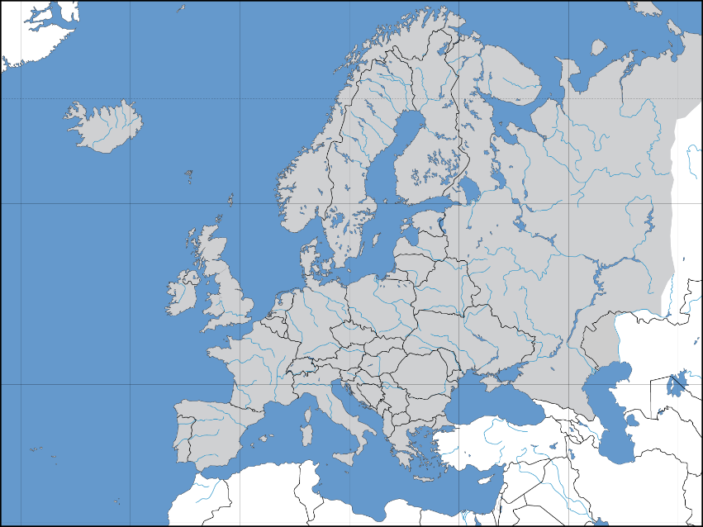
Ponto-Caspian Species
The Ponto-Caspian region is in between and including the Black and Caspian Seas
By David Liuzzo - Own work, CC BY-SA 3.0, https://commons.wikimedia.org/w/index.php?curid=1135831
Notes:
Firstly, we are going to look at the Ponto-Caspian species.
There are a number of species native to the Ponto-Caspian region that, in recent times, have begun to appear in Western Europe. A canal, completed in 1992 connected the Rhine to the Danube, and provided a single navigable route from the Black sea to the North sea. This facilitated the transport of invasive species to both Eastern and Western Europe. There a number that have appeared in Europe that are considered highly invasive, some of which have already reached the UK.

Slide 5
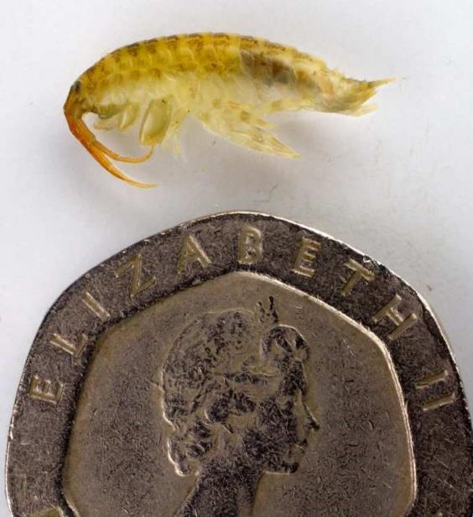
Killer Shrimp Dikerogammarus villosus
A Freshwater shrimp.
Larger than native freshwater shrimps – up to 30mm but usually 10-20mm long.
© GBNNSS
Notes:
The first species is the Killer Shrimp. A freshwater shrimp larger than native shrimps. Can grow to up to 30mm from tip of tail to tip of head, but more commonly around 10-20mm in length. It is thought to be one of the most damaging invasive species in Europe, and the UK Technical Advisory Group for the Water Framework Directive includes it on their list of high impact species.

Slide 6
Killer Shrimp Dikerogammarus villosus
Back is usually striped, but can be uniform
Key ID feature is two cones on tail
© GBNNSS
Notes:
Back is usually striped but can appear more uniform.
Key ID feature is two cones present on tail, which are absent in other, native shrimp species.
It is extremely similar to another invasive Dikerogammarus species, D. haemobaphes, which was found in 2012 and is well established, particularly in the midlands. If found, expert assistance should be sought to establish species.

Slide 7
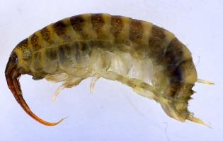
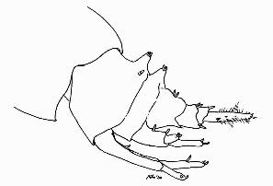
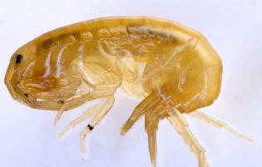
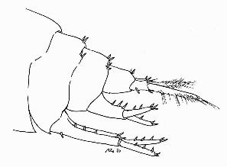
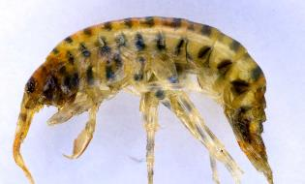
Killer Shrimp Dikerogammarus villosus
D. villosus with two distinct cones on tail topped with small spines
Gammarus pulex (native) has small clusters of spines or hairs but no cones
Gammarus tigrinus (non-native) also lacks cones. Has dark marks on back but not banded as in D. villosus
Line drawings © M.Dobson/FBA
© GBNNSS
Notes:
Killer shrimp can be confused with a couple of species, but under careful examination can be separated.
Native Gammarus pulex has no cones, only small clusters of spines or hairs. No distinct banding on back either.
Non-native Gammarus tigrinus also lacks cones, and has small clusters of hairs or spines. Shows dark markings on back but never banded as in villosus. Tigrinus is already well established in central England and is known from other sites, and is thought to be detrimental to native populations of shrimp. If found, also worth reporting.

Slide 8
Killer Shrimp Dikerogammarus villosus
Where found, it is found in large numbers.
Nocturnal, hiding under rocks and stones during daylight hours.
Known from a few places in the UK. Grafham Water (Cambs), Pitsford Reservoir (Northants) Norfolk Broads, Cardiff Bay and Eglwys Nunydd (near Port Talbot).
Can survive in poor quality water and in damp conditions for some time, so easily spread via equipment used in water.
Inhabits still or slow-moving freshwater or brackish bodies. Requires good levels of oxygen so rarely found at depth.
Often associated with Zebra Mussel.
Notes:
When found, it is present in large numbers. Nocturnal in behaviour, it hides during the day, and hunts at night.
It is known from a number of sites in the UK. Grafham Water in Cambridgeshire, Pitsford Reservoir in Northamptonshire, the Norfolk Broads, Cardiff Bay and Eglwys Nunydd near Port Talbot.
It is capable of surviving in poor quality water (e.g. in ballasts and highly polluted rivers where native species might be unable to survive) and in damp conditions. Therefore, excellent biosecurity (check clean dry) is especially important to stop spread, as it could be easily translocated on equipment used in water.
It inhabits both freshwater and brackish water, still or slow-moving. As it requires good levels of oxygen, it is rarely found at depth.
It is often associated with Zebra Mussel, which is another invasive species from the Ponto-Caspian region. It is believed they may have co-evolved.

Slide 9
Killer Shrimp Dikerogammarus villosus
Impact:
Killer Shrimp is a voracious predator of small invertebrates including fish fry, eggs and other native species.
It has the potential to displace other native species and disrupt nutrient processing.
Notes:
The Killer shrimp is a voracious predator of small invertebrates, including fish fry and eggs.
Amphipods play a major part in energy flow through freshwater ecosystems through shredding and decomposition. A change in dominant species could alter this flow.
There is currently no known way to treat or eradicate, so the focus is on ensuring tight biosecurity at sites where it is present to prevent or at least slow the spread. At sites where it is discovered, biosecurity measures would be reviewed and either checked/implemented to try and contain the species.

Slide 10
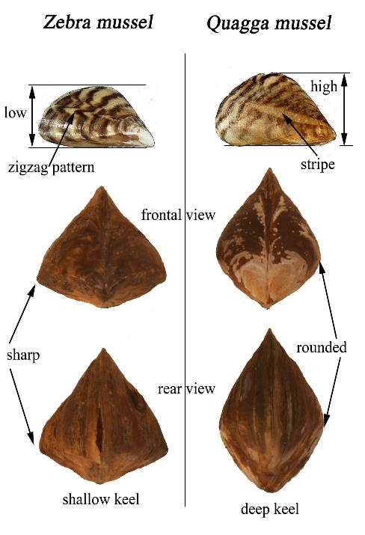
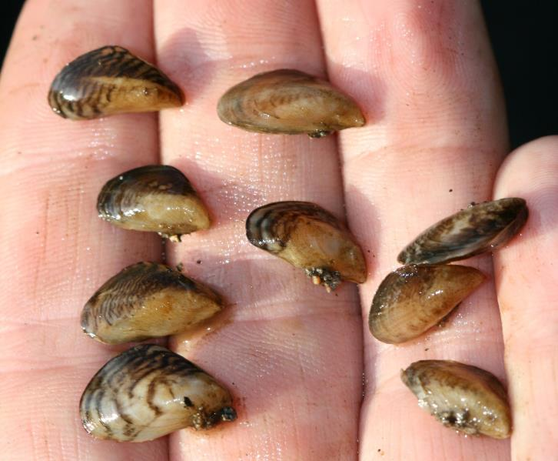
Quagga Mussel Dreissena rostriformis bugensis
© David Aldridge, University of Cambridge
© Dirk Platveot
Notes:
Next up is the Quagga Mussel, A highly invasive species. Similar to another invasive non-native species, the Zebra Mussel, but is separable on a few features.
At cross section, it is more rounded than Zebra Mussel. It has rounded edges that form a deep keel. Zebra Mussel has two sharp corners that form a shallow keel.
Quagga mussel has a central stripe, where Zebra Mussel has a zigzag pattern, but this is not always obvious.

Slide 11
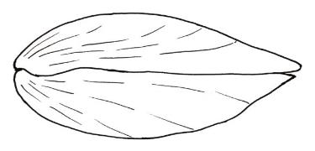
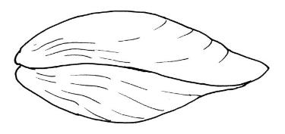
Quagga Mussel Dreissena rostriformis bugensis
Zebra Mussel
û
Quagga Mussel
ü
Large byssal groove
Straight seam
Small byssal groove
Undulating seam
© M Dobson / FBA
Notes:
Quagga Mussel has a small byssal groove vs Zebra Mussel’s larger one towards centre. Byssal filaments are used by the mussels to attach themselves or move around solid surfaces. This feature is not always obvious.
Quagga Mussel has undulating seam between shells vs Zebra Mussels straight seam.
Quagga Mussel tends to roll onto its side when placed on its front, whereas a Zebra Mussel will lie flat.

Slide 12
Quagga Mussel Dreissena rostriformis bugensis
Already established in the Wraysbury River and surrounding waterbodies in West London. Has spread rapidly across Europe from Ponto-Caspian region.
Can be spread as veligers (larvae) in bilge or ballast water, or as adults attached to boats, trailers or other equipment.
Found in freshwater bodies, but can tolerate weakly brackish water too. Can tolerate warm, cold, deep and shallow water and can survive in both hard and muddy substrates. Will attach to anything solid underwater.
Notes:
Established in West London (Wraysbury River and surrounding waterbodies) in 2014. It has spread rapidly across Western Europe and has the potential to do the same here.
It can either be spread as veligers (planktonic larvae) in ballast or bilge water, or as adults which will attach to anything solid (boat hulls, trailers or other equipment).
It is found in freshwater or weakly saline water. It is highly adaptable, surviving in cold deep water, as well as warm shallow water. It can also survive in areas with both hard and muddy substrates unlike zebra mussel, including sandy and silty bottoms. Will attach to anything solid underwater.

Slide 13
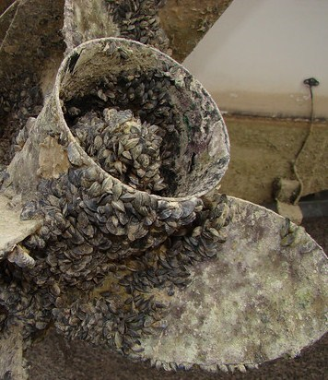
Quagga Mussel Dreissena rostriformis bugensis
Impacts:
Has the potential to significantly alter ecosystems by filtering out huge quantities of nutrients.
Also a serious biofouling risk, clogging pipes, smothering boat hulls, propellers and other structures.
© Utah Division of Wildlife Resources
Notes:
Quagga Mussel poses a significant risk to ecosystems and infrastructure where it colonises.
As a filter feeder, in large numbers it has the ability to filter huge quantities of nutrients from water bodies, taking this resources away from native species.
It can also cause problems to infrastructure through clogging pipes, fouling hulls and other structures.
There is currently no known way to treat or eradicate, so the focus is on ensuring tight biosecurity at sites where it is present to prevent or at least slow the spread. At sites where it is discovered, biosecurity measures would be reviewed and either checked/implemented to try and contain the species.

Slide 14
Reporting
Any sightings of Killer Shrimp or Quagga Mussel in the UK should be reported immediately – with a photograph and accurate location if possible.
Report sightings by using iRecord (https://www.brc.ac.uk/irecord/ or the iRecord app) or by emailing alertnonnative@ceh.ac.uk

Slide 15
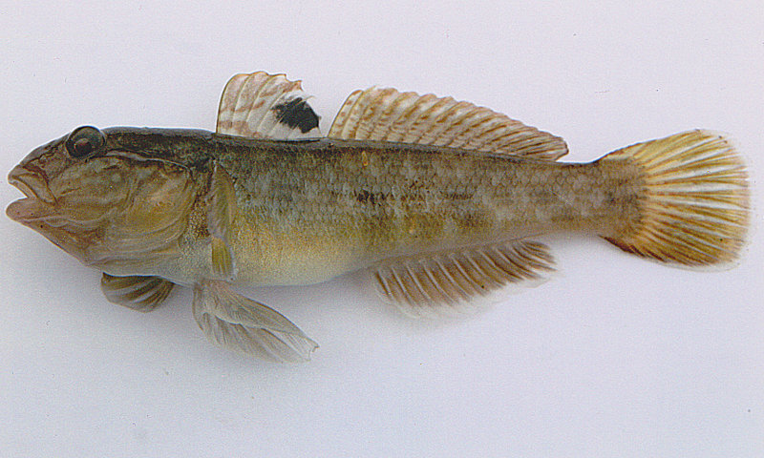
Round Goby Neogobius melanostomus
Key ID feature – black spot on end of dorsal fin
Fused pelvic fin identifies fish as a Goby
By Peter van der Sluijs - Own work, CC BY-SA 3.0, https://commons.wikimedia.org/w/index.php?curid=19438477
Notes:
The Round Goby is highly invasive in Western Europe,. It is not present yet in the UK, but is considered a highly likely invader in the next 5-10 years.
It is relatively large, up to 25cm in length. Size can be used as an initial clue as to species. Most British species less than 12cm in length e.g. Common Goby averages 6.4cm.
Goby's are notoriously difficult to tell apart.
Key feature to ID a goby is the fused pelvic fins that form a suction disk on the underside of the fish, providing it with anchorage in fast flowing currents.
Key feature for Round Goby is a large black spot, usually at the end of the dorsal fin.
Range in colour, from grey juveniles to adults which are mottled with grey, black, brown and green markings. Male Round Goby turn inky black in the breeding season.

Slide 16
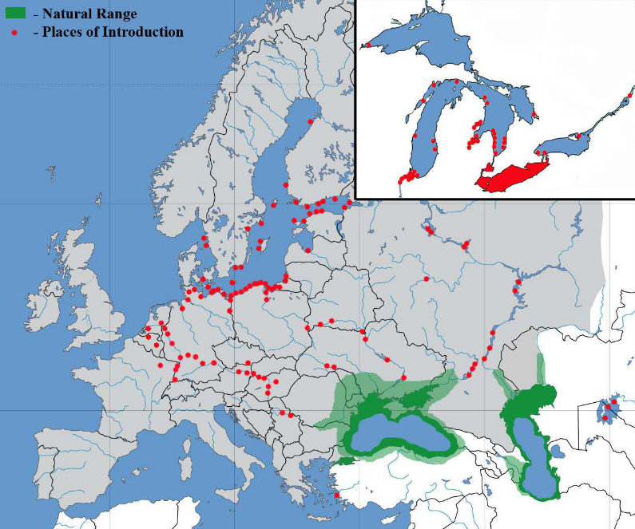
Round Goby Neogobius melanostomus
By Yuriy Kvach - Own work, CC BY-SA 4.0, https://commons.wikimedia.org/w/index.php?curid=35153980
Notes:
This map nicely illustrates how the Round Goby (and other Ponto-Caspian species) have spread across Europe.
The map in top right corner is of the Great Lakes of North America, where it has also established.

Slide 17
Round Goby Neogobius melanostomus
It is a bottom-dwelling species of fresh and brackish water. It is highly tolerant of changes in temperature and salinity.
Not yet established in the UK, but well established across Western Europe.
Spread as a hull foulant on boats and in ballast water.
Early detection is considered the best form of defence against this species.
Notes:
It is a bottom dwelling species of fresh and brackish water, and is highly tolerant of changes in temperature and salinity.
This species is yet to be recorded in the UK, however it has spread rapidly across Western Europe and introduction here is considered likely.
Eggs can be transported on hulls of boats or in ballast water, and adults can survive in ballast water too. Over short distances, it is even possible that adults could travel attached to the bottom of boats. Also possibly translocated through contaminated fish stocks.
It is considered that it will most likely be found initially in a river and estuarine system, with the south-east of England being most vulnerable. Early detection would be ideal to prevent spread.
The current contingency response doesn’t include any eradication measures. If a specimen was confirmed by the Environment Agency, biosecurity measures would be introduced at that site to attempt to contain/slow the spread. This would include an information campaign.

Slide 18
Round Goby Neogobius melanostomus
Impacts:
This species is an aggressive and territorial breeder, and so has the potential to displace native species.
It is a predator of young fish and eggs.
Also a known host species for native parasites.
Notes:
The round goby is an aggressive and territorial breeder, so it has the potential to displace and out-compete native species.
It is a predator of young fish and eggs.
It is also a known host of native parasites. This is the last of the Proto-Caspian species in this talk.

Slide 19
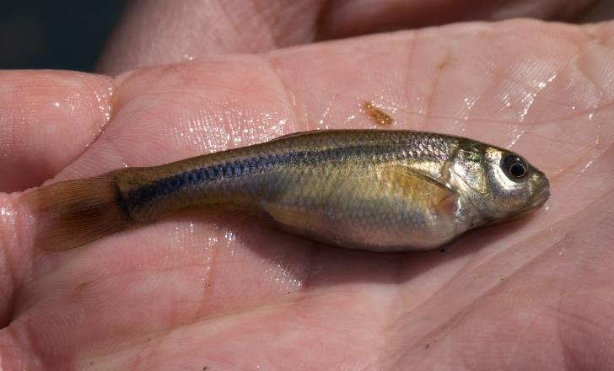
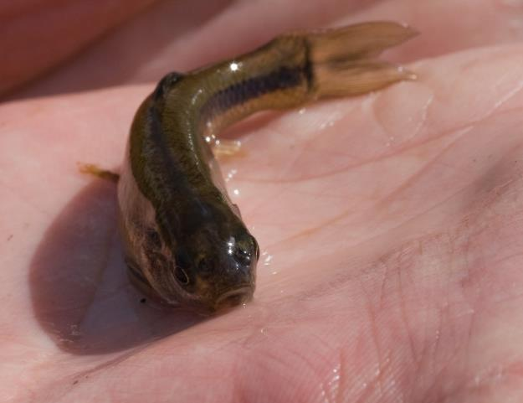
Fathead Minnow Pimepales promelas
© GBNNSS
© GBNNSS
Notes:
The Fathead Minnow is a small (4-8cm average, max 10cm long), fish with a distinctly rounded head.
Can be pink/golden in colour which is where it gets its other name “Rosy Red” from.
Dorsal fin contains 8 soft rays and has a dark blotch.

Slide 20
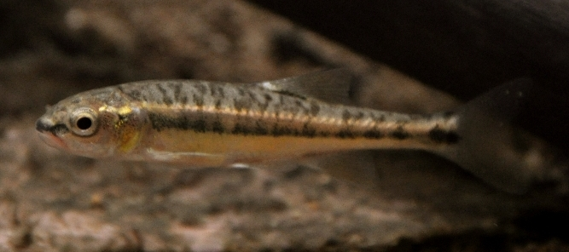
Fathead Minnow Pimepales promelas
Confusion species: Common Minnow Phoxinus phoxinus
Black and gold stripe along flank
Distinctive black spot on wrist of tail
Common minnow. Photo credit Adrien Pinot.
Notes:
Fathead Minnow can be similar to the Common minnow Phoxinus phoxinus, which is extremely common throughout the UK.
Key differences are the shape of the head and patterning. Common Minnow has blotchy patterning along the dorsal side of the body, and can show a distinctive black and gold stripe. The dark spot on the wrist of the tail is also distinctive.

Slide 21
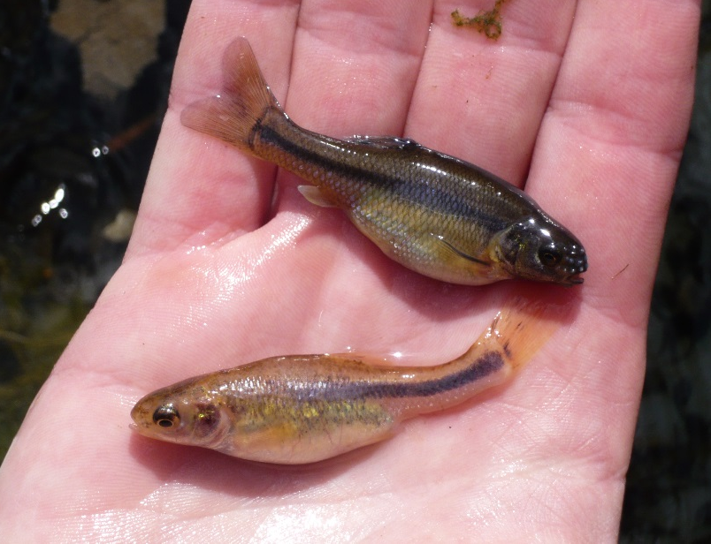
Fathead Minnow Pimepales promelas
Native to North America, introduced in a private pond in 2003, and first recorded in the wild in 2008.
Feeds on plants, detritus and benthic invertebrates.
Only established population in the UK was eradicated in 2010.
Very common in aquariums and private ponds. Favours streams and muddy ponds.
Currently no recorded impacts, but if established it is likely to compete with native species and disrupt food webs. It has also been associated with the spread of disease to native species.
Photo credit: Gordon Copp
Notes:
This photo shows a comparison of male (right) and female (left).
The Fathead Minnow is native to North America, but is very common in aquariums and garden ponds. It can tolerate turbid and poorly oxygenated water, but favours streams and muddy ponds. Will also survive in small rivers.
Feeds on benthic invertebrates, plants and detritus.
There was a single population that established in the UK which was successfully eradicated in 2010. Although there are currently no impacts recorded in the UK, if this species was to establish in large densities it would likely compete with native species and disrupt the food web. It has also been associated with the spread of disease to native species.

Slide 22
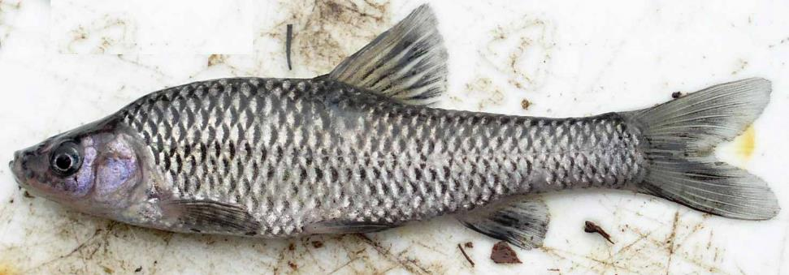
Topmouth Gudgeon Pseudorasbora parva
Lateral line is full and straight on Topmouth Gudgeon
© Matt Brazier - Environment Agency
Notes:
A small, slender fish, between 4-8cm long.
Key ID feature is the full, straight lateral line. Lateral lines are scales that have small holes which are used for sensing movement, vibration and pressure changes in water. Topmouth Gudgeon has a 34-38 scale lateral line, compared to Fathead Minnow which has incomplete lateral line (41-54 scales), Common Minnow which has 80-100 scales in lateral line.
Topmouth Gudgeon lateral line can show a thin, dark purple/blue stripe. The scales are quite large for a small fish, and have dark edges.
Small, high-set mouth with upturned lower jaw is where it gets its name from.

Slide 23
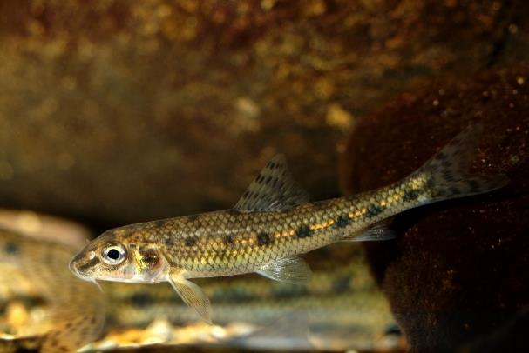
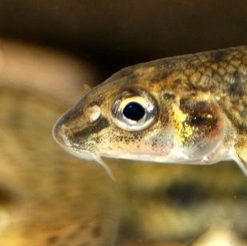
Topmouth Gudgeon Pseudorasbora parva
Confusion species: Gudgeon Gobio gobio
The native Gudgeon has two barbels beside its mouth
Gudgeon Gobio gobio
Photo credit Gilles San Martin.
Notes:
The Gudgeon Gobio gobio is native to Europe and the UK. Superficially similar, they have a row of black spots down each flank, but the key difference is the presence of a small barbel at each corner of the mouth. It is also usually slightly bigger (10-15cm) than Topmouth Gudgeon.

Slide 24
Topmouth Gudgeon Pseudorasbora parva
Topmouth Gudgeon are native to East Asia.
They were first recorded in the wild in 1996, having been introduced through contamination of other fish stocks. They are also present in the ornamental trade from which they can escape.
There are a number of populations in isolated lakes across England, and there are three known populations in Wales. Not known from the wild in Scotland.
Populations in Cumbria and London have been successfully eradicated.
They are bentho-pelagic, usually found in well-vegetated small streams, rivers, canals, drains and ditches.
Notes:
Native to a number of river basins and the Korean peninsula in south east Asia.
Topmouth Gudgeon is a popular ornamental fish and is believed to have established through contamination of other fish stocks and an introduction into an ornamental lake in Cheshire has also been noted.
Most populations exist in isolated lakes, but dispersal can still be achieved as their small size facilitates escape, as well as the fact that they lay their eggs on a number of solid surfaces which can include marine equipment (boats, trailers, buoys) which may then be moved to another water body, accidently introducing the eggs to this new location. They are also sometimes used as live bait, and can then subsequently escape.
Two populations have been eradicated, one through treatment with chemicals (in Cumbria), and another through depletion (in London), and so eradication is possible.
The species is bentho-pelagic, and tolerates a reasonably wide variety of habitats and conditions. They hide in densely vegetated parts of water bodies, and so it is possible for them to go undetected. Females can lay thousands of eggs per spawn, and spawn up to 4 times a year. Males aggressively guard the eggs until the hatch, therefore increasing the productivity and meaning that this species can reproduce rapidly.

Slide 25
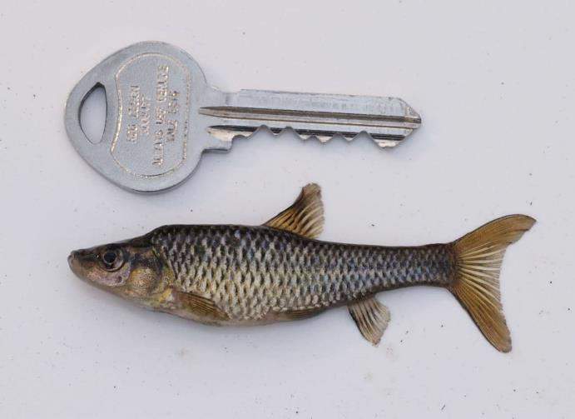
Topmouth Gudgeon Pseudorasbora parva
Impacts:
Can outcompete native species for food and spawning areas.
Known vector of disease.
Pest to anglers.
© Matt Brazier - Environment Agency
Notes:
Can reach very high densities (60 or more fish per square metre), at which point they outcompete native species for both food and spawning locations. One study has shown that in the presence of Topmouth Gudgeon, no freshly hatched native fish species were detected in searching exercise, and growth of older fish was severely stunted.
This impact can come from direct predation on invertebrates or fish fry/eggs and through or through increased eutrophication of water through their consumption of zooplankton. As zooplankton graze on phytoplankton, the presence of the latter increases and thus increases eutrophication.
It is also a vector of infectious diseases and therefore represents a serious threat to both native and farmed fish stocks.
It is also known to be a pest to anglers as it is known to take bait from hooks.

Slide 26
Reporting
Any sightings of Round Goby, Fathead Minnow or Topmouth Gudgeon in the UK should be reported immediately – with a photograph and accurate location if possible.
Report sightings by using iRecord (https://www.brc.ac.uk/irecord/ or the iRecord app) or by emailing alertnonnative@ceh.ac.uk

Slide 27
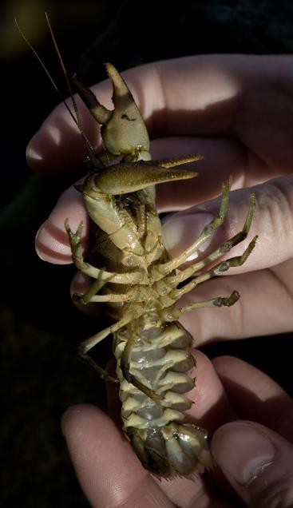
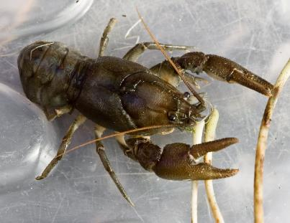
White-clawed Crayfish (native) Austropotamobius pallipes
This is the only native species of Crayfish in the UK, the White-clawed Crayfish.
It is under serious threat from a number of invasive crayfish species.
Identifiable by its underside – coloured dirty-white to pink. Upperparts brown to olive with rare blue morph.
© GBNNSS
© GBNNSS
Notes:
This time, we’ll start with a native species, the White-clawed crayfish, the only native species of crayfish in the UK. It is under serious threat from a number of invasive non-native crayfish which will be discussed now. It has also faced threats from habitat loss, pollution and crayfish plague.
Firstly, ID for the WCC. It is usually 10cm long, rough above usually brown to olive coloured (rare blue morph also possible) but key ID feature is dirty white/pinky underside.
Things to note if interested in crayfish. WCC is heavily protected by law and should not be disturbed. It is listed under schedule 5 of the Wildlife and Countryside Act 1981 and is listed as endangered on the IUCN red list, therefore a licence is needed to handle them to carry out survey work. For more information about this visit the Buglife website (buglife.org.uk/uk-crayfish-hub).

Slide 28
Crayfish
Species | Scientific name | Present in UK | Plague Vector | Resource Competition | Habitat
Signal Crayfish | Pacifastacus leniusculus | Yes | Yes | Yes | Wide range. Capable of moving some distance overland
Noble Crayfish | Astacus astacus | Yes | Susceptible | Potentially | Wide range
Narrow-clawed Crayfish | A. leptodactylus | Yes | No | Yes | Wide range, including brackish water
Red Swamp Crayfish | Procambarus clarkii | Yes | Yes | Yes | Wide range, including saline water. Capable of moving some distance overland
Marbled Crayfish | P. species | No | Yes | Yes | Unknown but probably wide ranging
Spiny-cheek Crayfish | Orconectes limosus | Yes | Yes | Potentially | Wide range. Will tolerate pollution, habitat drying, brackish water and silty, muddy river bottoms.
Virile Crayfish | O. virilis | Yes | Yes | Yes | Wide range, including extreme winters. Sensitive to deoxygenation.
Rusty Crayfish | O. rusticus | No | Yes | Yes | Wide range
White River Crayfish | P. acutus acutus | Yes | Yes | Yes | Sloughs, sluggish streams, ditches, floodplains. Burrows into sediments.
Notes:
There are currently 7 species of invasive non-native crayfish present in the UK. There are two (Marbled and Rusty) that have not yet reached the UK but are considered likely to reach UK shores. The Marbled Crayfish is only known from the aquarium trade, and no native population has been found. Closely related to American species P. fallax. Now illegal to posses in aquariums but is still found in ornamental trade, where it is popular due to its colouration.
It is under serious threat from a number of invasive species of Crayfish, the most common of which is the Signal Crayfish Pacifastacus leniusculus. There are 5 other species, and two which aren’t in the UK yet but likely to arrive.
It faces competition from these more aggressive species which also act as vectors for Crayfish Plague, a disease threatening the native species. The only non-native species vulnerable to the disease is Noble Crayfish.
Non-native crayfish are also voracious predators of other native species in river systems so can disrupt ecosystems, and some burrow for winter causing bank erosion and increasing turbidity of water systems.
All can survive in freshwater lakes, rivers, ponds, lakes and reservoirs = wide ranging. A few are able to tolerate more extreme conditions. Signal Crayfish are capable of crossing considerable distances overland. Narrow-clawed and Red Swap are capable of living in brackish/saline water. Marbled crayfish habitats are unknown but probably wide ranging. Spiny-cheeked are particularly tolerant of a range of conditions, including heavy pollution, temporary desiccation of habitat and brackish water. It will also live on soft-bottomed, silty, turbid and muddy waters. Virile crayfish can tolerate extreme cold winters, but is sensitive to deoxygenation and Rusty can also tolerate softer substrates.
Here we will cover the ID of Red Swamp and Marbled (priority because Marbled is not in the UK and red swamp is only in small numbers)

Slide 29
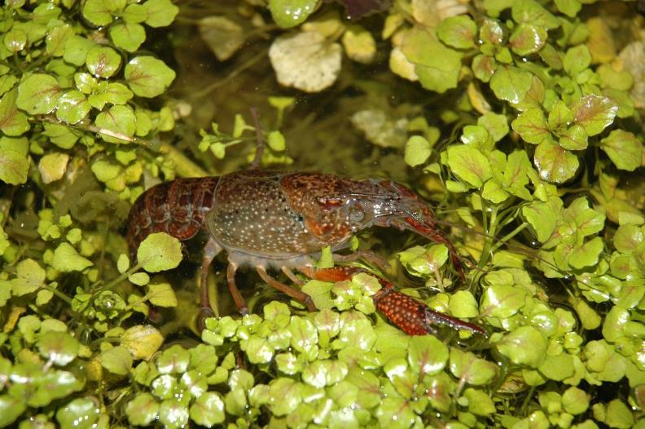
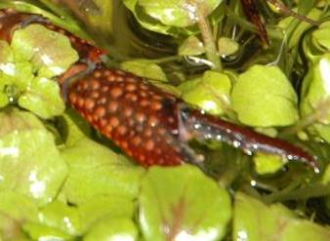
Red Swamp Crayfish Procambarus clarkii
Key ID feature is the red colouration on both sides of the claw and bright red spines on top.
Photograph by Trevor Renals
Notes:
The Red Swamp Crayfish is a native of the south-eastern USA and northern Mexico.
It is usually 10-15cm long and red-dark red in colour. Light brown to green when young.
It is capable of surviving in a number of habitats, including saline waters. One of the burrowing crayfish, which means it can cause damage to banks and increase water turbidity.
It is known from a few sites in London, with the first wild record in 1990. It has the potential to expand rapidly, as it is tolerant of a range of environmental conditions and is capable of traveling considerable distances over land.

Slide 30
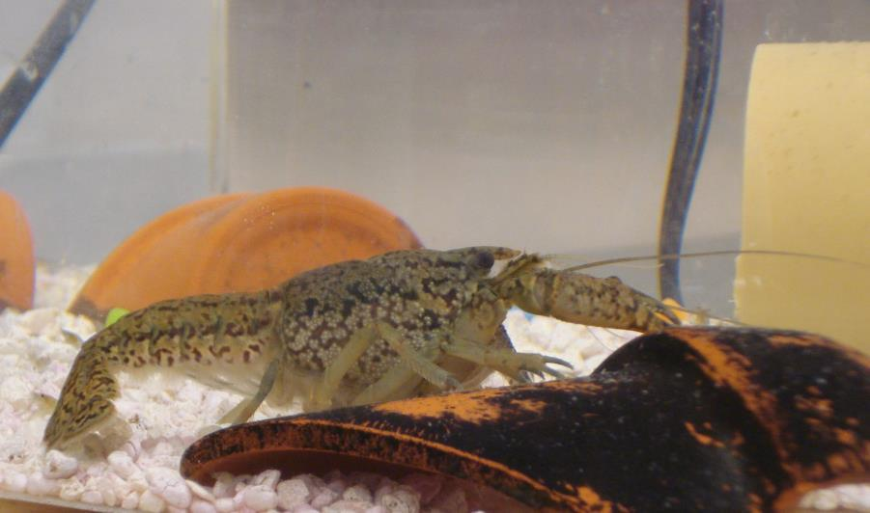
Marbled Crayfish Procambarus spp.
Distinctive marbled body makes this crayfish unmistakable.
Also has relatively small claws compared to other Crayfish
By Zfaulkes at English Wikipedia - Own work by the original uploader, Public Domain, https://commons.wikimedia.org/w/index.php?curid=64827932
Notes:
Medium sized crayfish on average 10cm long, but can reach 13cm. Its small claws and marbled patterning make it unmistakable.
It is not known where this species originates, but it has so far been found in the wild in Germany, the Netherlands, Italy, Madagascar and Japan. It has so far only established populations in Madagascar and Germany. It is a serious threat as it is rapidly expanding in Madagascar, and as it is capable of parthenogenesis (asexual reproduction). Females can produce up 270 eggs every 8-9 weeks and is likely to be able to reproduce year-round.
As it has such high reproductive output, it is a voracious predator of plants and animals and as other invasive crayfish species have had some disastrous consequences for native biodiversity, it is expected that the Marbled Crayfish would follow the same pattern.

Slide 31
Reporting
Any sightings of Signal Crayfish, Red Swamp Crayfish, Marbled Crayfish, or any other non-native crayfish species in the UK should be reported immediately – with a photograph and accurate location if possible.
Report sightings by using iRecord (https://www.brc.ac.uk/irecord/ or the iRecord app) or by emailing alertnonnative@ceh.ac.uk

Slide 32
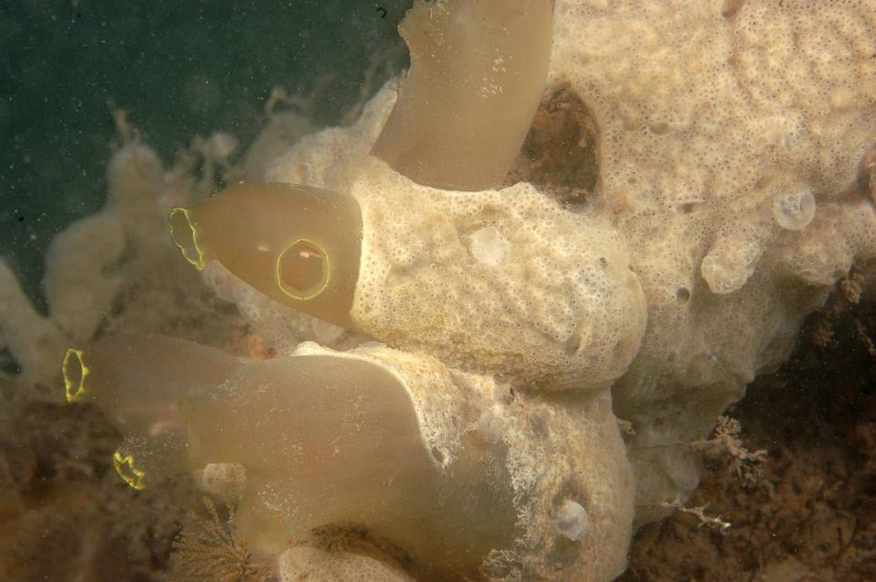
Carpet Sea-squirt Didemnum vexillum
© CCW
Notes:
The carpet sea-squirt is a colonial tunicate, a filter feeding invertebrate found in marine environments. They draw water through holes in their exterior and filter the contents and then expel the water through another hole. Almost all tunicates are sessile (including the carpet sea squirt) meaning that they are permanently attached to a solid surface on or near the ocean floor.
It is pale orange, cream or off-white and forms extensive colonies of thin (2-5mm) sheets, sometimes with long pendulous outgrowths as can be seen in this picture. It has a tough, leathery texture and marbled appearance. It has numerous small pores in the surface which close when the colony is disturbed.

Slide 33
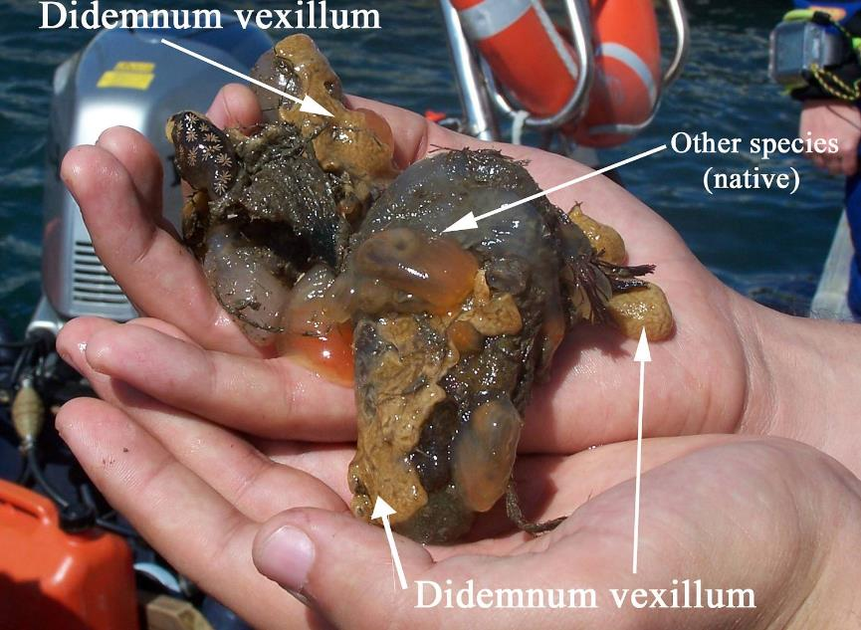
Carpet Sea-squirt Didemnum vexillum
© Niall Moore
Notes:
Another picture showing a sample out of the water, with some native species for comparison.

Slide 34
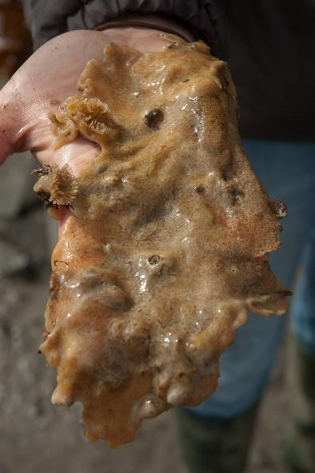
Carpet Sea-squirt Didemnum vexillum
Native to the NW Pacific.
The Carpet Sea-squirt is found purely in marine environments.
It is known from 6 marinas in the UK where it has established populations.
Association with marinas suggests that transfer on the hulls of leisure craft is the main dispersal mechanism.
Movement of aquaculture has played a role in some introductions.
Capable of reproducing rapidly.
© CCW
Notes:
The sea squirt is native to the NW Pacific, and it is likely that is has spread from Japan. In Europe it has spread to the Netherlands (1991), then northern France (1998), Ireland (2005) and northern Spain (2008). It has also been found in cooler coastal waters off Japan (1926), on the east and west coasts of the USA (1982 and 1993 respectively) and in New Zealand (2001).
In Britain, the carpet sea squirt has been found only in marinas and on adjacent shallow artificial structure, to depths of between 30 and 60m and temperatures between -2 and 24°C. In other areas of invasion, it has been found at depths of 80m on natural gravel seabeds, in tidal pools, in seagrass beds and on bivalve aquaculture installations.
In the UK, the populations are in North Wales, Devon, 3 in the Solent, and Clyde. Single or small colonies have also been found on the Isle of Wight.
Its association with marinas suggests that the species is likely dispersed on the hulls of leisure craft. Populations in Ireland on oyster trestles have been associated with imports of stocks from northern France. Larval stages have very limited free-swimming period (minutes to hours) and adults are sessile, so long-distance dispersal either through contaminated commercial oyster shipments or relocation of fouled boats or other floating structures.
It reproduces via an asexual budding process. Small colony fragments can increase 11-fold in just 15 days. Larval production occurs between 14°C and 20°C in US

Slide 35
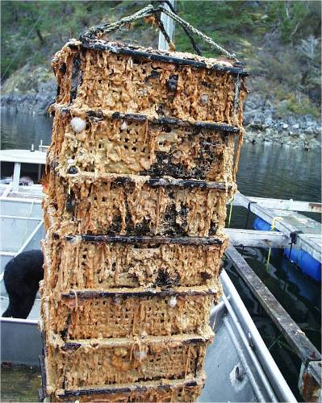
Carpet Sea-squirt Didemnum vexillum
Impacts:
Carpet sea-squirt is known to form very large colonies, and as such is likely to have an impact on existing sessile hard-surfaced communities.
Larvae of some shellfish have been shown to avoid settling on this species and it can overgrow mussels and aquaculture equipment.
© CCW
Notes:
Carpet sea-squirt is capable of forming very large colonies, and is likely to have considerable effect on existing sessile hard surface communities through overgrowth interactions. In Oosterschelde in the Netherlands, where carpet sea-squirt covered over 95% of substratum, there was a dramatic decline in brittlestar and sea-urchin numbers. In Massachusetts, it has had a dramatic impact on species composition of benthos compared to uncolonised areas.
There are also possible impacts on the shellfish industry as well. Larvae of the Bay Scallop Argopecten irradians avoided settling on sea-squirt colonies, which suggests that where the sea-squirt is present, there will be reduction in suitable settlement area. It has also been seen overgrowing mussel and aquaculture gear in New Zealand. However, despite initial concerns and a substantial expenditure on control measures, effects were less severe than initially feared and farmers decided to live with it rather than continue control measures.

Slide 36
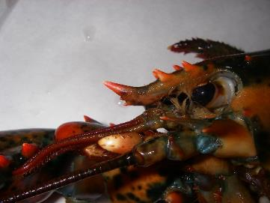
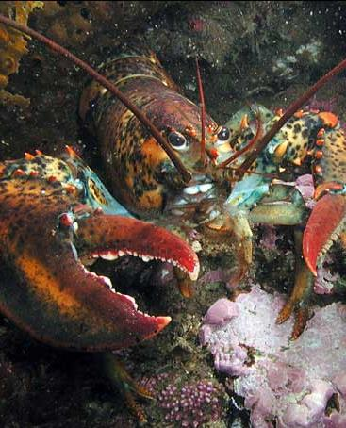
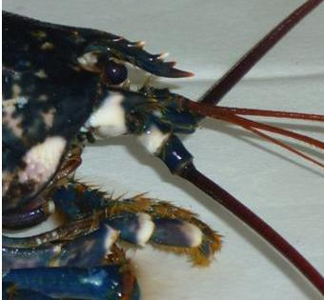
American Lobster Homarus americanus
Key characteristic is presence of small ventral tooth on rostrum
Spines on rostrum and claws red or tipped red
© GBNNSS
Teeth absent from ventral side of rostrum on European Lobster and spines tipped white
© GBNNSS
Notes:
The American Lobster is a large crustacean, similar to our native European Lobster Homarus gammarus. The American lobster is generally larger, reaching lengths anywhere between 8 and 24 inches, compared to 9 to 15 inches for European Lobster. European Lobster has been recorded as reaching 24 inches though.
Separating the two species can be difficult and sometimes expert advice will need to be sought, so any suspected specimens should be retained. That said, there are a couple of features which can clinch ID.
American Lobster has one of two small teeth located on the ventral side of the rostrum, which are absent on European Lobster and the spines on the rostrum and claws are red or tipped red, compared to white or tipped white on European.
European lobster is generally darker, either blue or dark blue, whereas the American is orange-reddish to dark green, sometimes with black speckles. The underside of the American Lobsters claws are orangey-red compared to European which are off-white or very pale red.

Slide 37
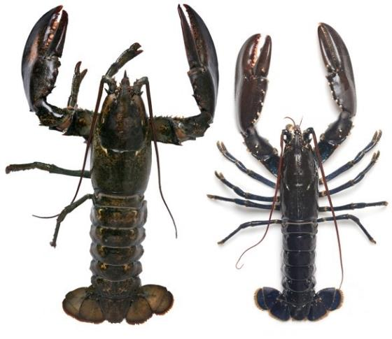
American Lobster Homarus americanus
Native to the North-eastern coast of the USA and Canada.
Can be found in a variety of marine habitats from shallow to deep water, but key feature is adequate shelter.
Known from a few records (less than 30) in UK waters, mainly around the south and south west coast.
At present it is not believed to be established in the UK, as sightings are believed to be a result of either deliberate release or escaped animals.
Size comparison – American Lobster (left) vs European Lobster

Slide 38
American Lobster Homarus americanus
Impacts:
The American Lobster is considered to be a serious risk to the native European Lobster Homarus gammarus.
They are larger, more aggressive, highly fertile and are more tolerant of a variety of habitats.
Threats come from competition, hybridisation and the spread of disease.
Notes:
The American lobster is considered to be a serious threat to the native European lobster Homarus gammarus.
They are larger and more aggressive, and can reproduce at more rapid rate, meaning that they are highly likely to be able to outcompete the native species. They are also have a greater tolerance for different habitats. They not only pose a threat to the European Lobster, as competition for resources could also impact species such as the brown crab, which alongside European Lobster are important economical species.
Hybridisation between the two species is also known from the wild. Lab tests showed that only female hybrids are fertile, which could eventually, if invasion was to happen across the range of the native lobster, render it genetically extinct.
The American Lobster carries a blood disease gaffkemia, which is endemic in American Lobster and causes high mortality in its native range, but 100% mortality within just a few days in European Lobster. The disease is capable of surviving outside the lobster in slime on carrying crates and tanks, and so could easily be transported to Europe. As yet there is no indications that it has reached the UK or Europe.
The American Lobster also carry Epizootic Shell Disease, which renders the animals unmarketable and has caused the closure of some US fisheries, thus having a serious economic impact. Despite it not usually being fatal, it can make the lobster more susceptible to other diseases which will then cause mortality.

Slide 39
Reporting
Any sightings of Carpet Sea-squirt or American Lobster in the UK should be reported immediately – with a photograph and accurate location if possible.
Report sightings by using iRecord (https://www.brc.ac.uk/irecord/ or the iRecord app) or by emailing alertnonnative@ceh.ac.uk

